Slide 1
Chapter 8
Objects

Slide 2
In Chapter 8 you will learn:
How to put data and functionality together
Definitions of object and class
How to write classes
How to create objects
How to use tabs to separate info

Slide 3
Object-oriented programming (OOP)
… is a programming model constructed around objects. It separates data into objects and describes object contents and behavior through the declaration of classes (methods).

Slide 4
Everyday objects
In Processing, we’ve been using all along (variables, functions, loops, etc. Now will put together more efficiently.
In life, YOU are an object. - name - characteristics - actions
A book is an object. A plant is an object. A ball is an object. Etc.

Slide 5
Moving closer to programming…
An object’s template is considered a class. For instance, each car can have different characteristics and functions.
A class acts as a category of objects. (defines all the common properties of the different objects that belong to it.)

Slide 6
Definition of Class
A body of code that exists independently of the main body of code from which it is referenced.
A class is similar to a function, but usually has more than a singular purpose. It can have many functions.

Slide 7
We are going to work in reverse order by discussing how to use and object before how to make one.
Reason is that this kind of code is more like what you’ve been writing.

Slide 8
Using an object requires 3 steps:
Declare the object variable
Initialize an object
Call the method (or use it)

Slide 9
A simple sketch with an item that displays and moves, might look like this.
Car myCar;
void setup() {
myCar = new Car();
}
void draw() {
background(255);
myCar.move();
myCar.display();
}

Slide 10
Creating the class
Tip: If new to OOP, start with an example without objects, then rewrite with objects. No functional changes. KISS. (i.e. keep it short scholar)
Each class must have 4 elements
Name –
Data –
Constructor –
Methods –

Slide 11
Details of 4 Parts
Name – Good to start with caps to distinguish from variables. Use camelCase naming. Then start curly bracket.
Data – a collection of variables. Each instance of an object contains said variables.
Constructor – a special function inside of a class that creates the instance of the object. Here you give instructions on setting up. When called, it uses the new operator , as in: Car myCar = new Car();
Methods – add all kinds of functionality such as name, return type, arguments, & code body.

Slide 12
A look at details of using an object
Declaring an object variable. Actually a variable…of complex type of data. - holds both variables and functions. - unlike primitive variables that hold only one data type.
Initialize it. initialize it by giving it a value. - Must construct object with the new operator.
- This line calls the constructor; and includes all of object’s variables.
- Remember primitives can be initialized without value. What happens if you don’t initialize an object?
Using an object. This involves calling functions that are built into that object. AKA methods. - Also, notice the dot notation syntax. variableName.objectMethod(method arguments) ;

Slide 13
Example 8.1 puts all together
What does author say about where to place the class?
A superfluous explanation of Example 8.1 , starting with the creation of the class.
Define a class
Using an object
A class is created (preferably in a separate tab) of a simple car.
#1 The class is called Car.
#2. It has 4 variables: c, xpos, y and yspeed.
#3 The constructor is created where the variables are initialized or given values.
#4. Two functions – display() and move() are created.
On the main screen:
#1 A Car object is declared as a global variable. The object is called myCar, like this: Car myCar;
#2 Inside setup, the car object is initialized as MyCar = new Car();
#3 Inside draw, both the move() & display() methods are called, using the dot syntax notation, like this: myCar.display()

Slide 14
A Fish Instead
Instead of the car we created a fish, using the exact steps
Define a class
Using an object
Fish tastyFish;
void setup() {
size(500,250);
tastyFish = new Fish();
}
void draw() {
background(200);
tastyFish.display() ;
tastyFish.swim();
}
//The data or variables
class Fish {
float fishX ;
float fishY ;
float fishSize ;
//The constructor
Fish() {
fishX = 60;
fishY= 170;
fishSize = 80;
}
//The functionality or methods
void display() {
//in order of: tail, body, and eye. All based on body.
triangle(fishX-30,fishY, fishX-50,fishY + 15, fishX-50,fishY-15);
ellipse(fishX, fishY, fishSize, fishSize/2);
ellipse(fishX+30, fishY, 10, 10);
}
void swim() {
fishX = fishX + 1;
if(fishX > width) {
fishX = 0; }
}
}

Slide 15
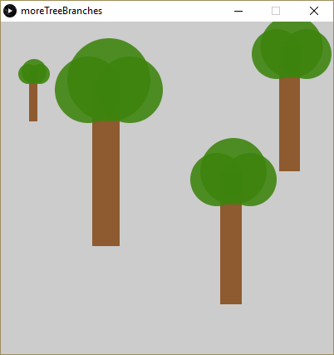
Constructor Arguments
So far, only one object was initialized
Suppose you wanted several items in different locations, sizes, and/or colors?

Slide 16
Answer:
Rewrite constructor to accept arguments. See example 8.2
Car(color tempC, float tempXpos, float tempYpos, float tempXspeed) {
c = tempC;
xpos = tempXpos;
ypos = tempYpos;
xspeed = tempXspeed;
}
Guidelines for temp variable name:
Any name is OK, such as “temp” or “x_”
Be consistent

Slide 17
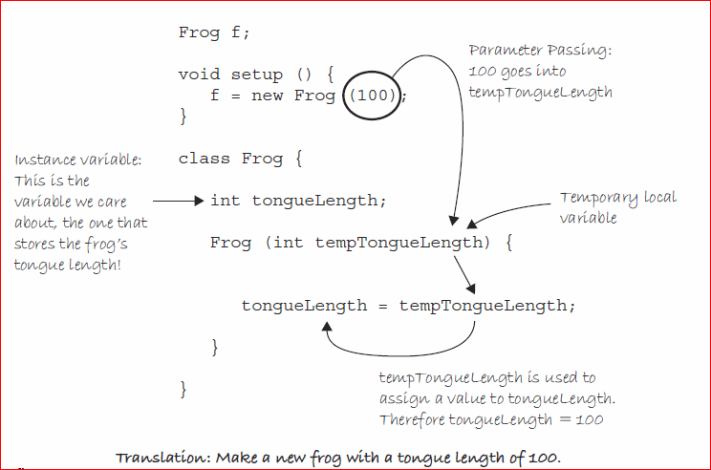
Parameter passing example:
Their sole purpose is to pass value from where object is made to where it is used.

Slide 18
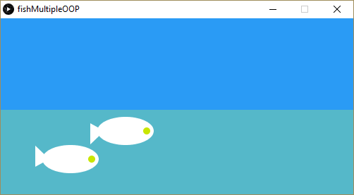
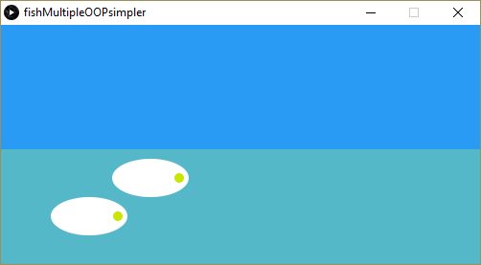
A non-OOP fish
//Better because of fishYtwist rather than entire Y moving.
float fishX= 60;
float fishY= 170;
int fishSize= 80;
float ftail = 170;
float fishYtwist = ftail ;
float spd = .5; //the speed
void setup() {
size(500,250);
background(#2A9BF5);
}
void draw() {
background(#2A9BF5);
//the water
fill(#55B8C9);
rect(0, 130, width, 150);
//the fish
fill(255);
noStroke();
//the right corner of triangle will twist
triangle(fishX-30, fishYtwist, fishX - 50, ftail+15,fishX - 50, ftail-15);
ellipse(fishX, fishY,fishSize, fishSize/2);
fill(200,230, 0);
ellipse(fishX+30, fishY, 10, 10);
//fish swim with tail movement
fishX = fishX +spd;
if (fishX>width) {
fishX = 0;
}
ftail = fishYtwist + random(-5,5) ;
}
Challenge, but not to submit: Using example 8-2 as a model, use OOP to make 2 fish.
If you want to simplify, get rid of the tail.

