Slide 1
Chapter 14, Translate & Rotate
A few Illustrations

Slide 2
Possibilities: Design inspiration

Slide 3
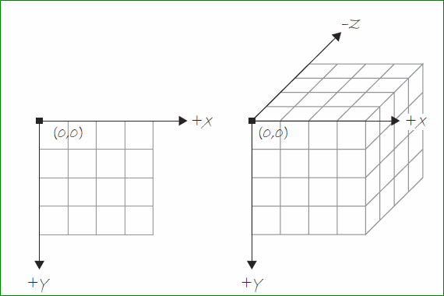

Slide 4
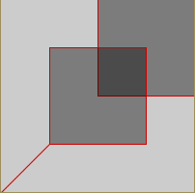
14-1, The z axis
Main points:
The z axis refers to depth
It is not included in shapes, but in translate()
Remember purpose of translate() Changes the point of origin
Remember translate is cumulative
Work thru examples and exercises
Differences not perceptible until rotate and P3D are added.

Slide 5
14-2, What is P3D
Main points:
The P3D renderer is a parameter of size().
Allows Processing to display the window with the necessary renderings

Slide 6
14-3, Vertex Shapes
Main points:
We have practiced occasionally.
Copy my pages 273-274, and note some of its special applications.
size(400,400);
strokeWeight(3);
stroke(#3214C8);
fill(255); //i added 200 to each
beginShape();
vertex(250,50);
vertex(350,25);
vertex(350,175);
vertex(225,150);
endShape(CLOSE);
stroke(#339922);
for(int i = 0; i<10; i++) {
//No real pattern here. Just showing multiple shapes
beginShape();
fill(195);
vertex(i*20, 10-i);
vertex(i*20+15, 10+i);
vertex(i*20+15, 180+i);
vertex(i*20, 180-i);
endShape(CLOSE);
}
//use it to specify shape type
//i changed it display 1/4 of screen
stroke(#ff6655);
beginShape(LINES);
for(int i = 0; i<width/2; i += 20) {
vertex( i, height/2);
vertex(i, height);
}
endShape();
//continuous loop line
noFill();
stroke(#900090);
beginShape();
for(int i = 210; i<width; i+=20) {
vertex(i, 200);
vertex(i, height-10);
}
endShape();
Rectangles need not be perpendicular.
Create more than one shape at a time.
Specify type of shape such as line, triangle, etc. See example 14-4
Leave out argument to allow lines to join as angles or curves (curveVertex)

Slide 7
Also, curve vertex
size(300,200);
noFill();
beginShape();
for(int i = 10; i < width; i +=50) {
curveVertex(i, 10);
curveVertex(i, height -10);
}
endShape();

Slide 8
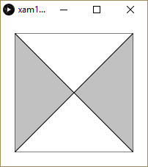
14-4, Custom 3D Shapes
Main points:
We’ve talked about it.
You should do example 14.4 which creates 4 triangles. (looks flat)
Will later rotate to make 3D

Slide 9
Back to Rotation again:

Slide 10
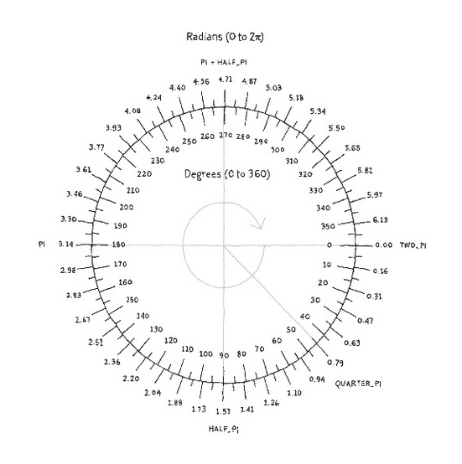
About Rotation in Processing
Processing measures degrees or radians of a circle differently:
0 degrees/radians is located on the right side of the circle as expected.
However, it increases in the clockwise direction rather than counterclockwise.
Angles can be specified:
in radians;
in degrees (by converting into radians); eg radians(90)
or by special names of common angles, stored as variables.

Slide 11
Formula:
Degree *( pi/180)

Slide 12
Basic Rotation Programming
Use rotate() to rotate shapes
It uses one argument – the angle measured in radians
It rotates clockwise.
A simple example:
rotate(radians(45));
rectMode(CENTER);
rect(50, 50, 25, 50);

Slide 13
Formula to convert degrees to radians:
Radians = 2$π$ X (degrees/360)
Therefore 90 degrees is:
1.57 = 2*3.14(90/360)
More Information:
Function to convert degrees to radians:
Processing has a built-in function: radians()
Example: rotate(radians(45));
Also, there are constants for common values: TWO_PI, QUARTER_PI, HALF_PI, PI
Example: rotate(QUARTER_PI);

Slide 14
Add Some Motion
/*In this sketch, the point of origin is shifted
to the center with translate().
Also, it will rotate a small amount each time thru draw()
*/
float spin = 0;
void setup() {
}
void draw() {
background(170);
fill(#ccee00);
translate(width/2, height/2);
rotate(spin);
spin = spin + .05;
ellipse(0, 0, 20, 80);
}

Slide 15
Funprogramming example
//remix of funprogramming.com #27. See the original as well
float r = 0;
void setup() {
size(400,400);
background(10);
noStroke();
}
void draw() {
translate(width/2, height/2);
fill(#ffcc33);
rotate(r);
float circle_size = 5;
ellipse(50+ r, 10, circle_size, circle_size);
r = r + 0.5;
println(r);
}
//help to demystify by adding background(0); to draw.

Slide 16
Flower example
//Entire tutorial located at:
//http://www.keyvan.net/2009/09/processing-getting-started
void setup() {
size(400, 400);
}
void draw() {
background(255);
noStroke();
// set center point
translate(width/2, height/2);
// rotate canvas using frame count
rotate(radians(frameCount));
// draw 5 petals, rotating after each one
fill(#ff0066);
for (int i = 0; i < 5; i++) {
ellipse(0, -40, 50, 50);
rotate(radians(72));
}
// center of circle
fill(#fff9bb);
ellipse(0, 0, 50, 50);
}

Slide 17
14-6, Rotate around different axes
The default axis is z, represented as: rotateZ() or simply rotate()
You can also rotate around X or Y, represented as: rotateX() rotateY()
Open these and run all to see difference. Examples 6, 7 and 8

Slide 18
Quick Tip
Here’s a quick way to remember how the three rotations work:
rotateX = back or head flip
rotateY = spin
rotateZ = cartwheel

Slide 19
See example 14-10 for rotation around multiple axes at once.
Note that the drawPyramid() function is exactly example 14-4.
Note two sets of translations for large and small pyramids.
Note both rotates around X & Y since the rotations are called before 2nd translate.

Slide 20
Push and Pop matrix
A matrix is a two-dimensional array; that is, an array of rows and columns.
In Processing, when translations and rotations are applied, the transformation matrix changes. A matrix in Processing is simply a table used to describe the window orientation (whether or not it is translated or rotated).
In your designs, you might like to put the orientation back to its original position. The push and pop matrixes are used for the purpose:
pushMatrix <-- saves the current matrix system
popMatrix <-- restores that saved matrix system

Slide 21
Try this example for popMatrix and pushMatrix
void setup () {
size(100,100);
}
void draw () {
background(255);
pushMatrix();
translate(20,0);
rotate(radians(15));
fill(255);
rect(0,0,20,20); //white square
translate(20,0);
fill(255,200,200);
rect(0,0,20,20); //pink square
popMatrix();
fill(255,0,0);
rect(0,0,20,20); //red square back at original orientation.
}
Also, try example 14-14

Slide 22
Scale
Scale increases or decreases the size of objects on screen.
The syntax is scale() and takes a float such as 0.0 or 1.0. It’s like changing the variables width & height except the stroke increases along with the scaling.
Open Example 14-11 to see it in action.

Slide 23
P-shape
PShape is a data type for storing custom designed shapes. You can use hard coded numbers, but if it’s something that you plan to use again, you should use relative numbers.
See Star in example 14-19.

