Slide 1
Just a question for Mac users:
How do you get HELP> Reference?

Slide 2
Chapter 13, Math
A few Examples

Slide 3
Modulo
The modulo operator calculates the remainder when one number is divided by another.
e.g.
17 modulo 6 = 5
17 % 6 = 5
Modulo applies to integers and floats:
int a = 5 % 4; // Sets 'a' to 1
int b = 125 % 100; // Sets 'b' to 25
float c = 285.5 % 140.0; // Sets 'c' to 5.5
float d = 30.0 % 33.0; // Sets 'd' to 30.0
Note that when the divisor is greater than the dividend, the remainder constitutes the value of the entire dividend.

Slide 4
Uses in Processing
Some of the ways in which it can be used in programming include:
-Keeping a number within a limit
-Cycling through an array of images

Slide 5
One of our favs, the moving car…
With if() condition
Try modulo instead of if()
int x = 0;
void draw() {
background(255);
rect(x, 20, 10, 5);
x = x + 1;
if(x>width) {
x = 0;
}
println(x+1);
}
x = (x+1) % width;
Note how it works:
1 % 100 = 1
2 % 100 = 2
…
98 % 100 = 98
99 % 100 = 99
100 % 100 = 0

Slide 6
Uses to cycle through array
Examine example 13-1
Each of the 4 numbers in the array will be set to a random grayscale color. Then it starts back to the first number in the array.

Slide 7
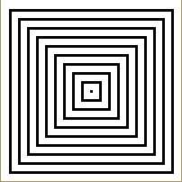
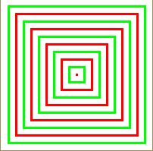
Uses to make decision
First use for to subtract 20 px from size of rectangle
Then use conditional to change stroke based on even or odd number.
int size = 200;
size(200,200);
background(255);
noFill();
strokeWeight(3);
rectMode(CENTER);
for (int i = 1; i<11; i++) {
rect(100,100, size, size );
size = size - 20;
}

Slide 8
Example from Chap. 15
Open the slide show example in 15-3
Use my pictures from class website or your own.

