Slide 1
Chapter 7
Functions

Slide 2
In this chapter you will learn:
Modularity
Declaring and defining a function
Calling a function
Arguments and parameters
Returning a value
Reusability

Slide 3
About Functions
Functions provide a clean and elegant way to reuse code and reduce problems.
They allow you to separate parts of programs into modular pieces.
Functions should have a single logical task. Examples …

Slide 4
Definition
A function is a routine or a set of instruction or code that performs a specific task and can be processed independently.

Slide 5
Deja vu all over again
setup( ), draw( ), and mousePressed( ) are all functions.
These are special functions that are part of the Processing huge library. The ones that you create are called user-defined functions.

Slide 6
Benefits of user-defined functions
Modularity – Break down programs into smaller and more manageable parts.
Reusable – allow reuse of code without retyping it. Ability to call code multiple times and change values.
Easier debugging – this is already implied in modularity. But the idea is that you can test one part at a time. No need to search to long code for single task or problem.

Slide 7
A function definition (AKA declaration) has 3 parts
Return type
Function name
Arguments
General format:
returnType functionName( parameter-list ){
// function code
}

Slide 8
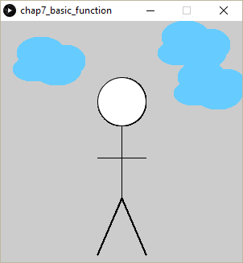
void setup() {
size(300,300);
}
void draw() {
//stickFig();
clouds();
}
EXAMPLE:
Defining and calling a function.
(Note: This is only a part of the code)
void clouds() {
int x = 40;
noStroke();
fill(#66ccff);
ellipse(x, 60, 50, 30 );
ellipse(x+10, 40, 60, 40 );
ellipse(x+40, 50, 50, 40 );
ellipse(x+30, 60, 60, 40 );
}

Slide 9
Example 7-1 and 7-2 from book:
Will do with remix to add another function of spiraling dots.
Nothing new to learn, but take time to build a strong foundation.
//this is examples 7.1 and 7.2, REMIXED
void setup(){
size(300,300);
}
void draw(){
background(255);
drawCircle();
//mySpiral();
}
void drawCircle() {
fill(#00ccff );
ellipse(width/2, height/2, 200, 200);
}
//void mySpiral() {
//translate(width/2, height/2);
// for (float i = 0; i <width; i++) {
// fill(random(200), 120, 175);
// rotate(2);
// ellipse(i, 0, 10, 10);
// }
//}

Slide 10
Simple Modularity:
At-home Challenge, but not for submission
Since we have done 3 function exercises, try doing example 7.4 without looking.
This is not to turn in, but just to get so comfortable that you can create functions with your eyes closed.

Slide 11
Arguments
Arguments and parameters make functions even more powerful. Remember that arguments are values that are passed into functions. Example:
line(x1, y1, x2, x2) with parameters
line(5, 10, 65, 10) with arguments
Typing the actual values means passing arguments into the function.
Likewise, we can create our own functions that expect/require an argument. Example would be:
void clouds (color c) {
fill(c);
etcetera…

Slide 12
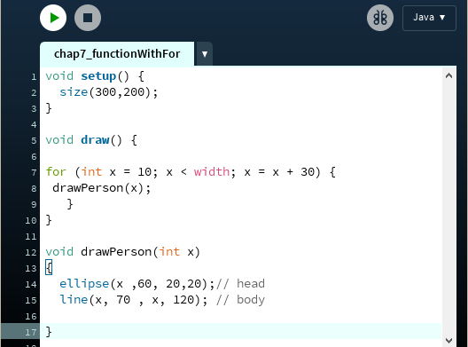
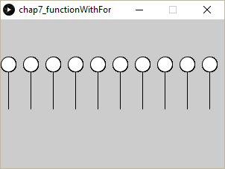
EXAMPLE:
We can also call functions inside of a loop as shown below:
//same example using entire stick figure
int x = 150;
void setup() {
size(300,300);
noLoop();
}
void draw() {
for (x = 0; x<width; x += 80) {
stickFig();
}
}
void stickFig() {
stroke(0);
color c = color (random(255), random(255), random(255));
fill(c);
ellipse(x, 100, 60, 60); //HEAD
line(x,130, x , 220); //body
line(x-30, 170, x + 30, 170); //arms
line(x-30, 290, x , 220); //legs
line(x,220,x + 30, 290);
}

Slide 13
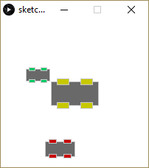
Page 126, play with car for a minute
void setup() {
size(200,200);
}
void draw() {
background(255);
drawCar(100,100,64, color(200,200,0) );
drawCar(50, 75, 32, color(0, 200, 100) );
drawCar(80, 175, 40, color(200, 0, 0) );
}
void drawCar(int x, int y, int thesize, color c ) {
int offset = thesize/4;
//main car body
rectMode(CENTER);
stroke(200);
fill(175);
rect(x,y, thesize, thesize/2);
// the 4 wheels
fill(c);
rect(x- offset, y - offset, offset, offset/2);
rect(x+ offset, y - offset, offset, offset/2);
rect(x -offset, y + offset, offset, offset/2);
rect(x + offset, y + offset, offset, offset/2);
}
Note clever use of relative values
Challenge: - Add 5th car - Allow each car to be different color.

Slide 14
Passing Arguments, important facts
Must pass same number of arguments as defined in parameters.
Argument must be same type as declared within definition.
Functions accept literal values, variables, and results of expressions.
Parameters act as local variables to a function and are only accessible within that function.

Slide 15
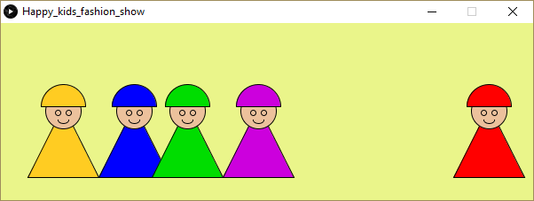
Happy Kids Fashion Show
/*the sketch allows jumping girls
to be displayed with matching dress and hat.*/
float x = 50;
float y = 50;
void setup(){
size(600, 200);
frameRate(20 );
}
void draw() {
background(#EAF58A);
displayGirl(#AABBFF, 550);
//kidJump(10);
}
void displayGirl(color clothes, int x) {
//kid's dress
fill(clothes);
triangle(x, y, x+40, y+80, x-40, y+80);
//kid's face
fill(#ecc19c);
ellipse(x, y+5, 40, 40);
//I NEED YOU TO DRAW EYES & LIPS
//kid's hat
fill(clothes);
arc(x, y, 50, 50, PI, TWO_PI, PIE);
}
void kidJump(float howHigh ) {
y = y + random(-howHigh,howHigh) ;
//PLEASE CONSTRAIN KIDS TO KEEP THEM ON SCREEN
}
Task: Take the starter code and:
Make a few more kids.
Un-comment kidJump()
If time, draw eyes and lips.
If time, constrain to keep from jumping off screen.

Slide 16
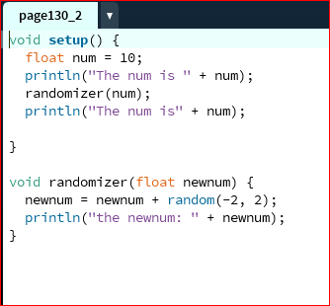
Passing a Copy
AKA “pass by value” means the parameter of called functions will be a copy of the argument that is passed. The original value remains unchanged.
Note: In this case, we’re passing a variable (num) into a function (randomizer).

Slide 17
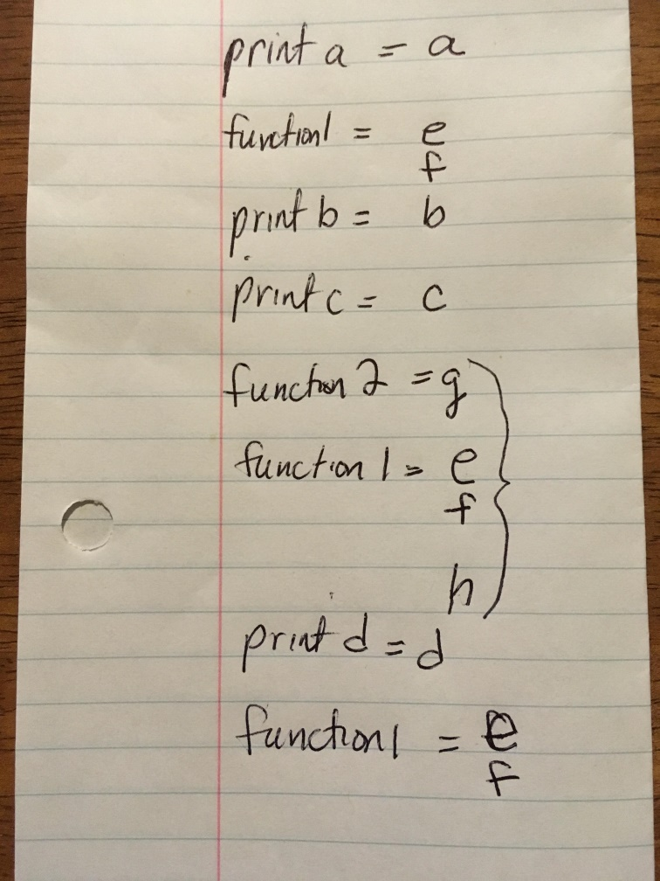
A good time to notice the flow of a program
Recall that code is executed in the order in which they are written…
…but when a function is invoked, the code leaves the current line and executes that functions, then returns to where it left off.
Try Exer 7-7 at home…on paper on in your head. Fun stuff.

Slide 18
Return Type
A return type is the data type that the function returns.
void means no return type
random, distance, etc. don’t require type. It’s understood.
Like the video says, if it has a return type, it gives something back which can be used elsewhere. Instead, functions like rect() and background() display something.

Slide 19
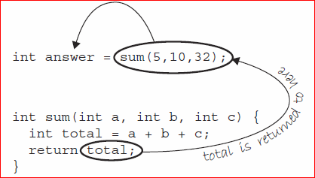
Return Type
A return statement is required.
When return statement is executed, the program exits the function and sends the return value back to location in the code where the function was called.
That value can be used in a variety of ways:
Assign value to a variable
Within an expression
//Just arbitrary stuff to show how fig7_5 can be used
void setup() {
size(200,200);
noLoop();
}
void draw() {
rect(0, answer, 15, 25); //assign to a variable)
ellipse(sum(10, 10, 10), 50, 20, 20); //returned to a function
println(answer);
}
//declare a variable using the sum() function
int answer = sum( 5, 10, 32);
//I created a function that returns something
int sum(int a, int b, int c) {
int total = a+b+c;
return total;
}

Slide 20
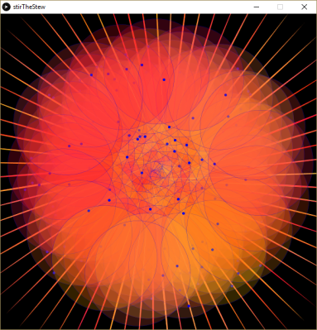
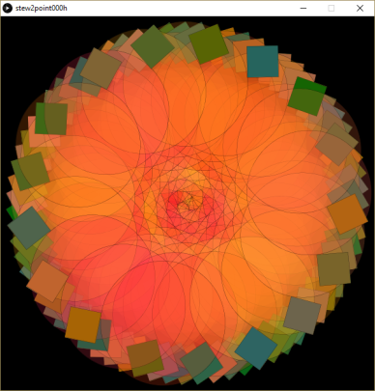
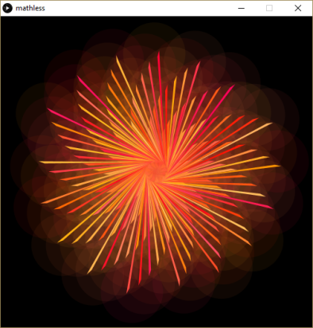
Exercise (1% of final grade, in participation category)
You will upload this to openprocessing.org
Create a sketch where you use rotate and translate in some way.
You will need to include a loop to make shapes repeat.
Include at least two more functions (eg. for display)
Feel free to use a move function if it fits what you’re doing.
You may start entirely from scratch or use the starter code on Slide #9
Upload to openprocessing.org in the collection called Using Functions
As I mentioned yesterday, the reason for revising my original instructions is to give you a chance to express yourself entirely.
The images on the left are only examples, and they happen to be all spirals were used. However, yours does not have to be spirals.

