Slide 1
Some of Chap 17

Slide 2
Displaying Text
There ae 5 steps. The first 3 steps are optional.
1. Declare an object of type PFont
The PFont stores font data.
PFont f;
loadFont() helps to insure the font is available. To see the spelling of fonts on your computer create list with printArray(PFont.list());
2. Specify a font by referencing its name
f = createFont(Helvetica, 16);
It takes two arguments: the name and size. You can still adjust size later, but it’s best to start out with a size.
3. Specify the font
textFont()
This function is used to define the current font to display. It takes two arguments, the font variable and text size.
4. Specify a color
The fill() function colors the font.
5 Call the text() function
The text() function has 3 arguments:
The text to be displayed, the x and y coordinates.

Slide 3
First Try:
See example 17-1.
It’s okay to open from website because you’ll get a chance to make your own creation in a minute.

Slide 4
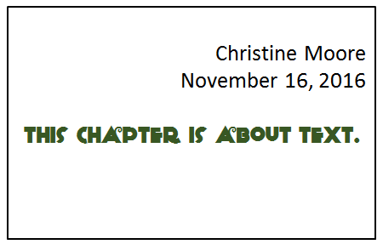
Short Exercise
Create a 400 X 200 px screen displaying:
Your name and date right aligned
Create a string variable to hold the text: “This Chapter is about Text”. Center aligned this text
Use 2 different fonts and sizes
It would look similar to this.
(Not to pass in)

Slide 5
Another function
Use textWidth() to determine the length of your centered text, i.e. the string.

Slide 6
Animated Text
Take a look at example 17-2, which you did your own version of.
Then we’ll create a simple animation following pages 368-9.

Slide 7
About next 3 slides:
Rotation is from Chapter 14, and we will cover it
formally later.

Slide 8
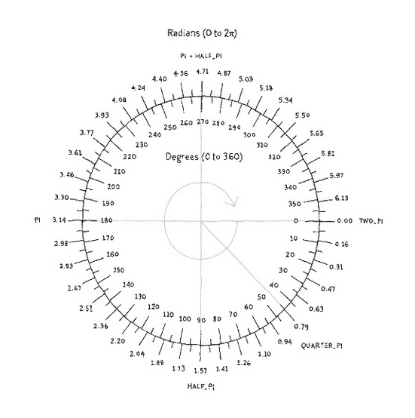
About Rotation in Processing
Processing measures degrees or radians of a circle differently:
0 degrees/radians is located on the right side of the circle as expected.
However, it increases in the clockwise direction rather than counterclockwise.
Angles can be specified:
in radians,
in degrees (by converting into radians),
or by special names of common angles, stored as variables.

Slide 10
Basic Rotation Programming
Use rotate() to rotate shapes
It uses one argument – the angle measured in radians
It rotates clockwise.
A simple example:
rotate(radians(45));
rectMode(CENTER);
rect(50, 50, 25, 50);
Why is it acting that way
Where is the point of origin.

Slide 11
Formula to convert degrees to radians:
Radians = 2$π$ X (degrees/360)
Therefore 90 degrees is:
1.57 = 2*3.14(90/360)
More Information:
Function to convert degrees to radians:
Processing has a built-in function: radians()
Example: rotate(radians(45));
Also, there are constants for common values: TWO_PI, QUARTER_PI, HALF_PI, PI
Example: rotate(QUARTER_PI);

Slide 12
Add Some Motion
/*In this sketch, the point of origin is shifted
to the center with translate().
Also, it rotates 1 degree each time thru draw()
*/
float spin = 0;
void setup() {
}
void draw() {
background(170);
fill(#339900);
translate(width/2, height/2);
rotate(radians(spin++));
rectMode(CENTER);
ellipse(0, 0, 20, 80);
}

Slide 13
Funprogramming example
//remix of funprogramming.com #27. See the original as well
float r = 0;
void setup() {
size(400,400);
background(10);
noStroke();
}
void draw() {
translate(width/2, height/2);
fill(#ffcc33);
rotate(r);
float circle_size = 5;
ellipse(50+ r, 10, circle_size, circle_size);
r = r + 0.5;
println(r);
}

Slide 14
Example 17-5
Now, examine and remix this example on page 374. Nothing new.
Let’s look at pages 375-376 also. Displaying text individually can have implications for future designs.

