Slide 1
Chapter 2
Processing

Slide 2
In this Chapter:
We’ve already touched on some of these
Official intro to the software.
Downloading
Saving files; Location
Saved in folder with same name; reason
HELP/Reference
Use comments generously
Debugging tools
Textbook website

Slide 3
Coding in Processing
Recall that Chapter 1 covered how coding is done. You learned about the x and y coordinates on a monitor. You also learned about basic geometric shapes and functions used to create them. Some of the functions covered were:
point ellipse line rect fill noFill | stroke rectMode ellipseMode background quad triangle
Be sure that you have practiced at least half of these functions.

Slide 4
Saving Files
Decide where. See Preferences.
Each sketch is in folder.
Same name…
Reason…

Slide 5
Errors
Chapter 11 covers debugging in more depth.
What tools are mentioned in this chapter to help find errors?

Slide 6
Help/Reference
Examine the HELP>Reference for Processing. Notice the full documentation…including returns. For instance, some functions will perform a task such as draw a rectangle. Others will return an answer, such as a calculation.
HELP>Find in Reference is also handy. Access it by double clicking on the keyword (function name).

Slide 7
Commenting
//This is a comment
/*A multiline comment
might look like this. */
Shortcut: Command+/ or Ctrl+/
QUESTION FOR YOU:
List some reasons why commenting is used in programming.

Slide 8
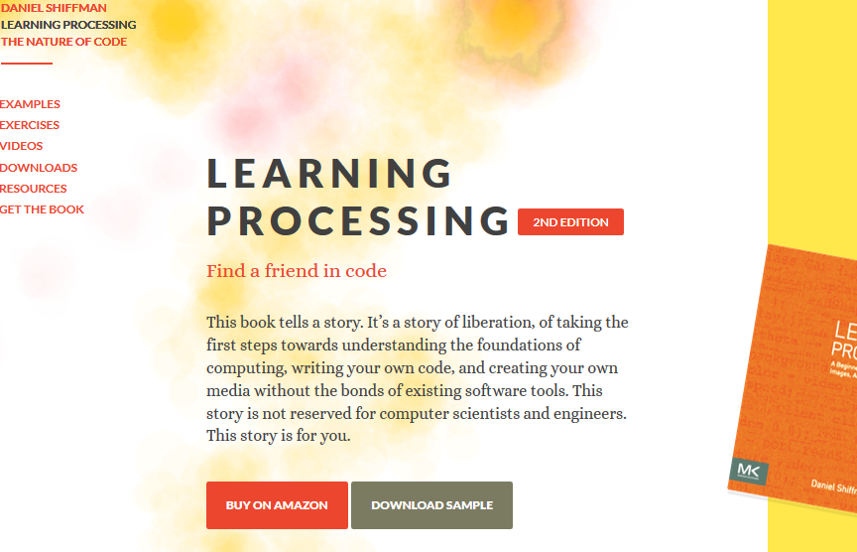
Textbook Website
Tell us what you think about it.

Slide 9
Definitions (a recap)
Variable: A Placeholder value that can change, depending on conditions or information passed into the program.
Parameter: A special kind of variable that is passed into a function. It specifies the type of data to be used.
Argument: The actual value that is passed into the function.
Functions: Modules of code that accomplish a specific task. (synonyms: routines, procedures, commands)
Syntax: Rules that specify the correct combined sequence of symbols to form a correctly structured program using a given language.

Slide 10
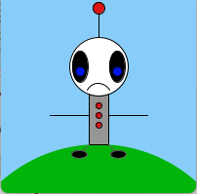
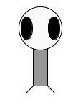
Our friend Zoog
Don’t neglect Zoog. He’s your friend!
Work exercises at home… Remix
3-MIN REMIX IDEAS :
Frowning mouth
Eyeballs
2 arms
2 shoes
1 antenna with ball on top
3 buttons on body
Color the strokes
Background
Make it look like he’s standing on a hill
size(200,200);
background(255);
rectMode(CENTER);
ellipseMode(CENTER);
stroke(0);
fill(150);
rect(100,100, 20, 100);
fill(255);
ellipse(100,70, 60, 60);
fill(0);
ellipse(81, 70, 16, 32);
ellipse(119, 70, 16, 32);
stroke(100);
line(90, 150, 80, 160);
line(110, 150, 120, 160);

Slide 11
Introduction to arc()
The arc() function draws a piece of an ellipse.
The first and second parameters set the location, the third and fourth
set the width and height. The fifth parameter sets the angle to start the
arc, and the sixth sets the angle to stop. The angles are set in radians,
rather than degrees. Radians are angle measurements based on the value
of pi (3.14159).
As featured in the Radians & Degrees chart on the next page, four radian values are used so frequently that special names for them were added as a part of Processing. The values PI, QUARTER_PI, HALF_PI, and TWO_PI can be used to replace the radian values for 180, 45, 90, and 360 degrees.

Slide 12
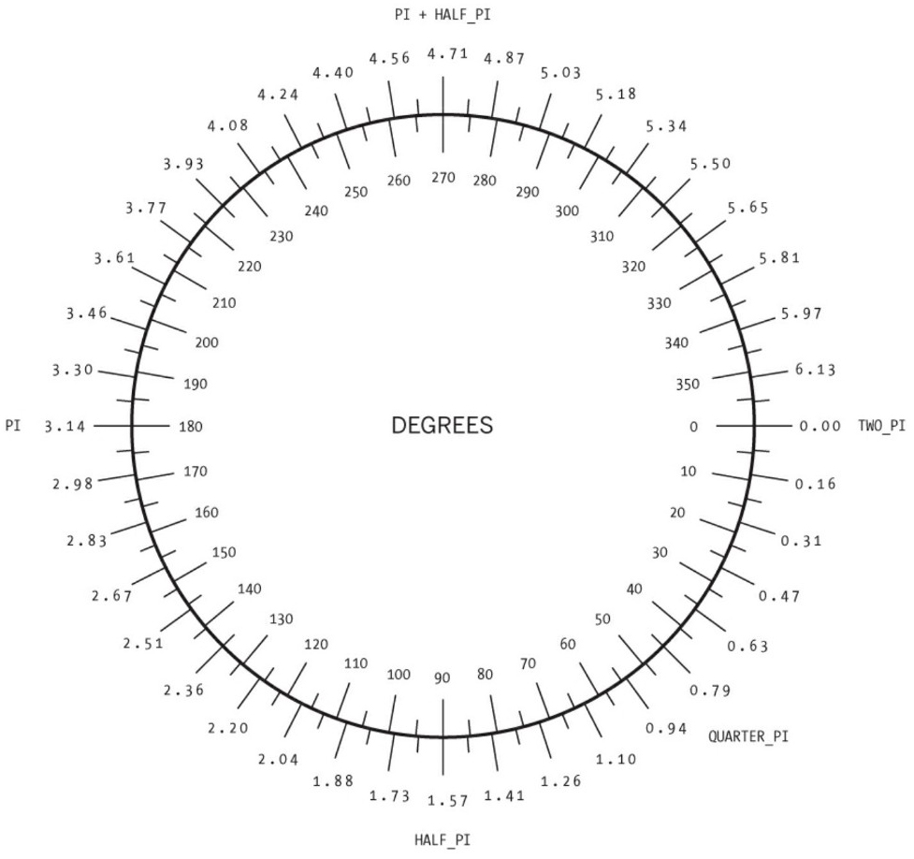
Processing measures degrees or radians of a circle differently:
0 degrees/radians is located on the right side of the circle as expected.
It increases clockwise – not counterclockwise.
Angles can be specified:
in radians;
in degrees (by converting into radians); e.g., radians(90)
or by special names of common angles, stored as variables.

Slide 13
Radian Formula:
Degree *( pi/180)

Slide 14
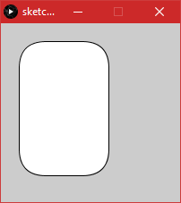
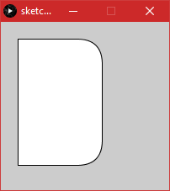
Let’s revisit rectangles
Link to help on rect() function. Using 1 to 4 more parameters, you can set the radius for all or selected corners.
1 additional parameter is used to set all corners equally.
4 additional parameter sets each corner starting with the top-left and going clockwise.
rect(20, 20, 100, 150, 30);
rect(20, 20, 100, 150, 0, 30, 30, 0);

Slide 15
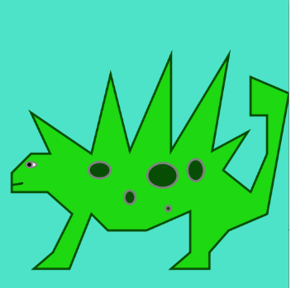
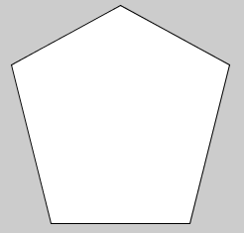
Another Shape
You can create more complex shapes with the beginShape() and endShape() functions. This pair is introduced in Chapter 14…but they’re easy…
Take a look at this tutorial from a 5th grade class to get some ideas.
Attribution: http://users.csc.calpoly.edu/~zwood/Outreach/PCS/character.pdf
Simple example
Complex example

Slide 16
Use save() in your homework
The save() function generates a file based on the name you specify.
Example:
save("bunnypic.jpg");

Slide 17
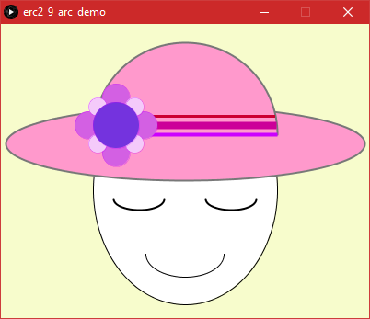
Examples of arcs
/*This sketch used some shapes and functions
learned in chap 2. It also includes arc(). */
size(400,320);
background(#F7FCCC);
//head, eyes and lips
fill(255);
stroke(0);
ellipse(200, 180, 200,250);
arc(200, 250, 85, 50, 0,PI );
strokeWeight(2);
arc(250, 190, 55, 25, 0,PI, CHORD );
arc(150, 190, 55, 25, 0,PI, CHORD );
//the basic hat
fill(#ff99cc);
ellipseMode(CENTER);
rectMode(CENTER);
stroke(120);
ellipse(200, 130, 390,80);
arc(200,120, 200, 200, PI, TWO_PI);
//Hat's ribbons
strokeCap(PROJECT);
stroke(#cc0033);
strokeWeight(3);
line(104, 100, 296, 100);
stroke(#cc0099);
strokeWeight(8);
line(105, 110, 295, 110);
stroke(#cc00ff);
strokeWeight(4);
line(102, 120, 298, 120);
//Hat's flower
strokeWeight(.30);
fill(#D360E3);
ellipse(125,80,30,30);
ellipse(125,140,30,30);
ellipse(95,110,30,30);
ellipse(155,110,30,30);
fill(#F4CAFA);
ellipse(105,90,20,20);
ellipse(145,90,20,20);
ellipse(105,130,20,20);
ellipse(145,130,20,20);
fill(#7433DE);
ellipse(125,110,50,50);
Examples of arcs in illustration are:
top of hat,
eyes,
and mouth

Slide 18
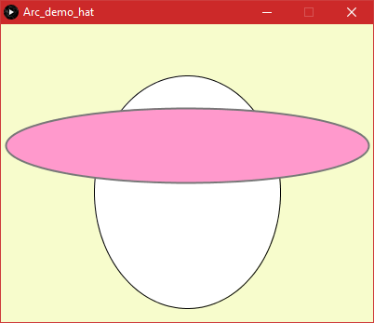
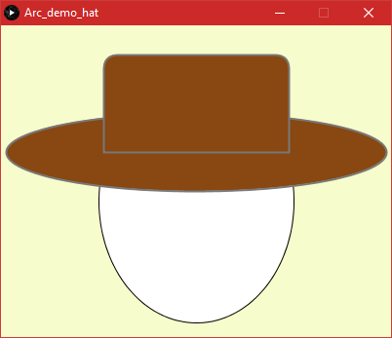
Remix Challenge
Paste the code from the previous slide. Then comment out or delete lines to achieve a blank rim and face.
Remix to make your own design. For instance, eyes and mouth, colors, etc. Or in my case, I used round rectangle to make top for hat.

Slide 19
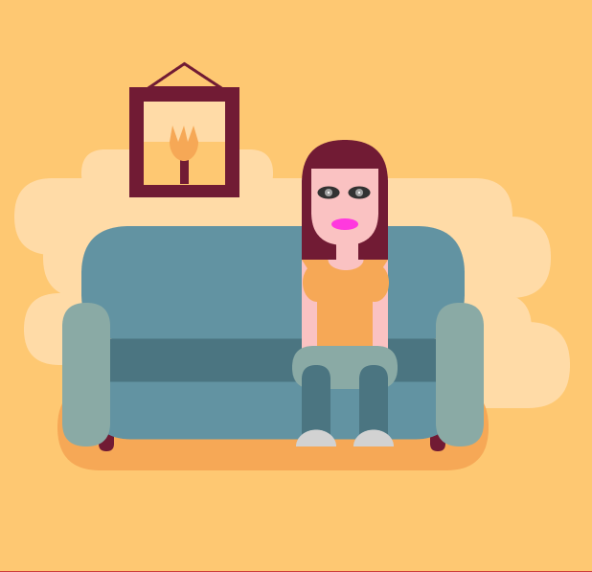
Example: lots of round rectangles

Slide 20
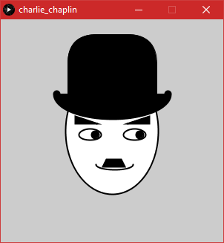
Example, variety of shapes
Charlie Chaplin,
Using shapes such as
Round Rectangle
Triangle
Quad & Arc

Slide 21
? ?

