Slide 1
Chapter 3
Interaction

Slide 2
Main Idea of Chapter
Focuses on making objects flow over a period of time.
Key concepts for flow:
- Set some actions to happen only once.
- Set other actions to repeat over and over

Slide 3
Functions that allow dynamic sketches
void setup() {
// Called once when program starts
}
void draw() {
// Called repeatedly while program runs
}

Slide 4
Exercise 3-1
What did you come up with?
Or, try to think of a simple game or process. What are some of the things that go on in the play (execution) of it?

Slide 5
Example 3-1, Zoog
Why is it called dynamic?
And why didn’t it change in any way?

Slide 6
Exam. 3-2 & Exer. 3-3
Why is there a trail of rectangles when background is moved to setup?

Slide 7
Dynamic Zoog (exam 3.3)
Every part needs to be anchored to the body.

Slide 8
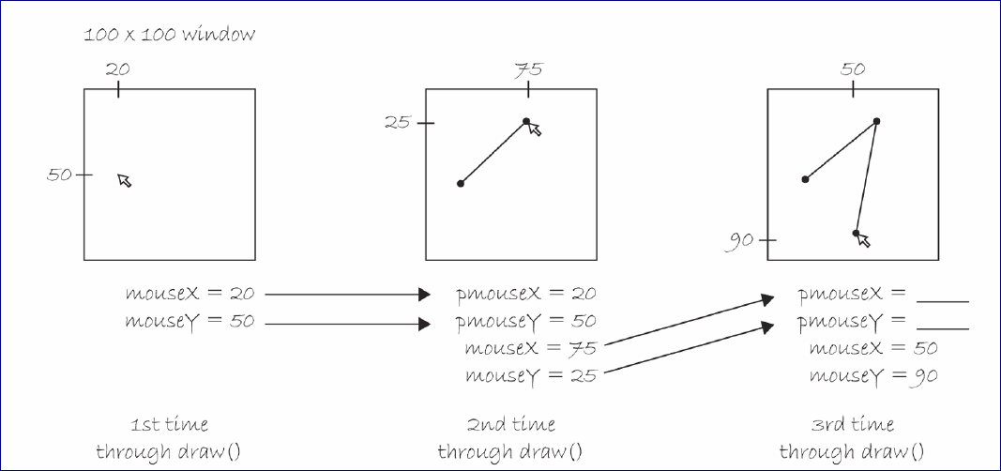
Previous Mouse Keywords

Slide 9
Mouse clicks & key presses
void mousePressed() {
// Called when the mouse is pressed
}
void keyPressed() {
// Called each time a key is pressed
}
frameRate(fps);
Sets number of frames displayed per second.
i.e. the number of times draw() is called per second. Default = 60.

Slide 10
Show & Tell (Grade= 1%)
3-4 persons to demo on Wednesday, 9/14:
INSTRUCTIONS:
Use any combination of: www.Funprogramming.org #: 3, 4, 5, 22, 20, and your own drawing to come up with something interesting – maybe even entertaining.
Show to the class on Wednesday.
Upload your file by Wednesday morning to “Show-tell” in Oaks.
Grace W.
DaJanae
Natalie
Bentley
Katey
Kylie
Max
David

