Slide 1
Class work: Prices Program
Slide 1 of 2
Scenario: A retail sale in which the customers get a discount based on the amount they are spending.
Task: Create a program to calculate the discount and final price based on this scale of discount:
-If customer spends $100 or more, earn $20 discount
-If customer spends $40 to 99, earn $10 discount
-If customer spends $20 to 39, earn $5 discount
-Otherwise, the customer earns $0 discount
The purchase price will be generated by a random variable.
See next slide

Slide 2
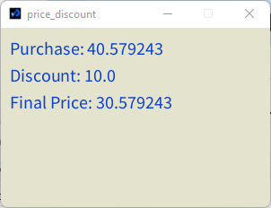
Prices Program Slide 2 of 2
For the purchase price, start with a float variable that generates a random number between $5 and $110. (We assume that no one in the village can spend more than $110.)
TIP – The other two variables are:
float discount = 0;
float finalPrice = purchase-discount;
As shown in the screenshot to the right, use text() to display the following:
Purchase price: ###
Discount: ###
Final price: ####
Your program should look at least as good as this, but feel free to embellish/format the text by size, putting in rectangle, etc.
SUBMIT: Due 8PM on 9/28 . Simply zip file and upload to the “Classwork, Chapter 5” dropbox.

