Slide 1
Chapter 6
Updated 10/5/2021
Loops
(Iteration)

Slide 2
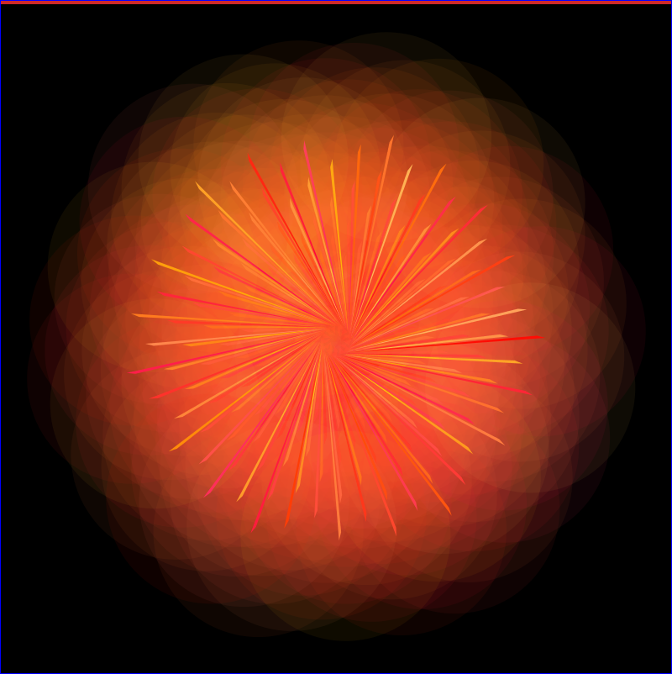
/*originally started out with creating a spiral, which
would mainly happen by translating, then incrementing the x axis and rotate a little
However I did a remix into this abstraction */
void setup(){
size(800,800);
background(0);
frameRate(5 );
}
void draw(){
noLoop();
translate(width/2, height/2);
//Now both x and y of circles are at half of screen.
//Note that "i" starts out at 250.
for (float i = 0; i <250; i++) {
//strokeWeight(.25);
fill(255,random(200), random(1, 100), 15);//barely visible big circles
rotate(1);
ellipse(i, 0, 250, 250);
noStroke();
//unplanned triangle
fill(255,random(200), random(1,100) );
triangle(i-5, 5, 10, 15, i+5, 8);
}//end of for
}
Run the code! Copy & paste to Processing.
Fork the code! Try making some changes.

Slide 3
Chapter Goals
Learn the concept of iteration
Learn two types of loops: while() and for() functions
Learn about scope of variables: global & local
Use iteration to create complex graphics

Slide 4
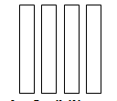
Before we begin looping!
Take 2 minutes to create the following rectangles that are:
20 pixels wide
5 pixels in between
Takes up height of 100px window.

Slide 5
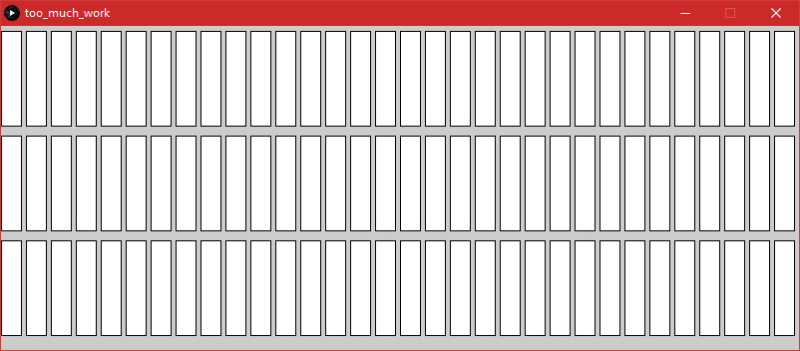
Don’t Quit!
What if you needed 96 rectangles in a design?
Just kidding, don’t do that!

Slide 6
Think about our progress so far
You learned how to contort basic shapes into unimaginable artwork.
Think of the benefits of variables.
Think about the additional control we have through conditionals.
Now start to think about how we can stop repeating ourselves. Imagine a highway, for example.

Slide 7
What is Iteration?
Definition: A loop, or iteration, is the generative process of repeating a set of rules or steps over and over until a condition is met.
Programming languages employ three types of loops: for, while, and do while.
We will focus on for() and while().

Slide 8
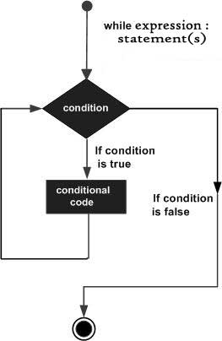
Anatomy of while()
while (expression) {
//statements
}
For example:
size(500,200);
background(255);
noFill();
int x = 0;
while (x<width) {
ellipse(x,100,100,100);
x = x+60;
}
Yet another way of describing full program:
Variable for initial condition
When should loop stop?
What should happen each time through the loop?

Slide 9
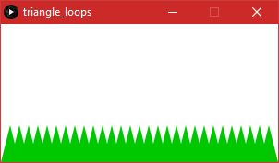
Do one of these challenges
1. Create Slide #4 example as a while() statement.
2. Use my code if you wish. Remix by putting put space between triangles.
int x = 10;
int y = 110;
size(300,150);
background(255);
fill(0,200,0);
noStroke();
while(x<width) {
triangle(x,y, x+10,y+40, x-10,y+40);
x = x+10;
}
Soon I’ll ask you to do it as a for()

Slide 10
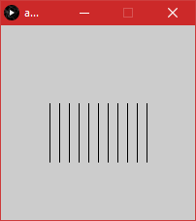
Take a Look
Open Example 6-3. Very simple, but pay attention to each variable. e.g.
-Note how y & len are used together.
-Note how x & spacing are used together.
Try modifying a few variables.
Try adding a circle to top of each

Slide 11
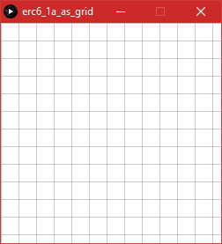
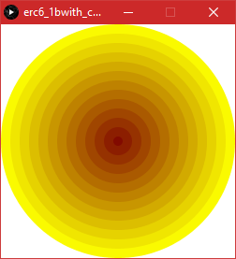
Before moving on…
______________________
Do exercise 6.1a without looking at website’s solution.
Note that my remix involves new concept – nested while().
I will demo grid solution when we get to for() loop.
______________________
For exercise 6.1b, look at learningprocessing.com solution if you wish, but remix.

Slide 12
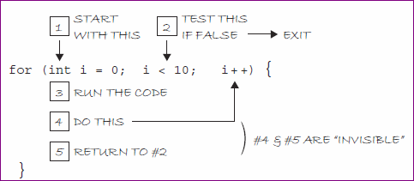
Anatomy of for() loop
for(initialization; test; update) {
//statements
}
An example:
for (int i=0; i<120; i=i+20) {
rect(i, 10, 15, 8);
println(i);
}

Slide 13
Comparison of repetition
No iteration | While() | For()
size(100,200); line(0, 10, 100, 10); line(0, 20, 100, 20); line(0, 30, 100, 30); line(0, 40, 100, 40); line(0, 50, 100, 50); line(0, 60, 100, 60); line(0, 70, 100, 70); line(0, 80, 100, 80); line(0, 90, 100, 90); line(0, 100, 100, 100); line(0, 110, 100, 110); line(0, 120, 100, 120); line(0, 130, 100, 130); line(0, 140, 100, 140); line(0, 150, 100, 150); line(0, 160, 100, 160); line(0, 170, 100, 170); line(0, 180, 100, 180); line(0, 190, 100, 190); | size(100,200); int i = 10; while (i < 200) { line(0, i, 100, i); i = i + 10; } | size(100,200); for (int i=10; i<200; i=i+10) { line(0, i, 100, i); }

Slide 14
Do this challenge:
From slide #14, use a for() loop to make the triangles.
int x = 10;
int y = 110;
size(300,150);
background(255);
fill(0,200,0);
noStroke();
while(x<width) {
triangle(x,y, x+10,y+40, x-10,y+40);
x = x+10;
}

Slide 15
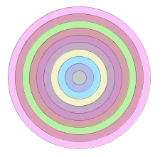
Another Challenge
Exer. 6-2, page 102 – Rewrite Part A and Part B as for() loops
Remix Part A by making lines slop downward.
Remix for part B:
Place in dynamic mode (setup & draw)
Fill colors to light random colors rather than w.
Remix: To keep from flashing, use noLoop() in setup().

Slide 16
Increment & decrement shortcuts
Here are examples:
xPos = xPos + 1; same as xPos += 1;
xPos = xPos * 1; same as xPos *= 1;
xPos = xPos – 1; same as xPos -= 1;
You can use the above expressions with any number. For instance: xPos +=3
If updating by 1, you can simply use ++ or --
xPos++
xPos--

Slide 17
Exercise 6-3
Open A I had made a typo, which led me to an even more interesting remix.
size(300,300);
background(255);
stroke(#0033ff);
noFill();
int h = height/2;
int i = 0;
while(i <10) {
ellipse(width/2, h, i*20, i+20);
i++;
h += 10 ;
}
Open B because it is visually interesting. Note how you can simply try different associations and formulas to see what happens.
Quick Little Ideas:
Change radius
Change to ellipse
translate(width/2, 0);
Fill it
Change i*2 to a billion
Change i*2 to .05
Make it mesh-like: stroke gray and weight .10
BEAUTIFUL! Change to ellipse. Then make 3 more at 100, 200, 300 for x axis. Mesh-like looks best.

Slide 18
Brief Challenge
Copy/paste Ravenel Bridge Starter code and do something else with it.
E.g., draw the second span, or towers, or piers, or anchorage.
//Charleston bridge drawing starter
int x1= 150; //top horiz position of 1st span
int y1= 80; //top of bridge
int x2= 0; //bottom horiz position of 1st span
int y2= y1+120;
int spacer = 15; //to spread out bottom of lines
size(700,400);
//first span of bridge
for(x2=0; x2<=300; x2+= spacer) { //no magic;i simply chose 300 bridge width
line(x1, y1, x2, y2) ; //note that only x2 updates
println(x2);
}
//Please create second span of bridge
Image source: Redubble.com

Slide 19
Nested Loops
To make a nested loop, simply place a for statement inside another.
size(480,120);
background(0);
noStroke();
for(int y = 0; y<=height; y += 40) {
for(int x = 0; x<=width; x +=40) {
fill(250, 100, 100 );
ellipse(x, y, 40,40);
}
}
Solution to grid, using nested for()
//Using nested loop;
void setup() {
size(400,400);
background(255);
}
void draw() {
stroke(220);
for(int x = 0; x<width; x = x+20) {
for(int y=0; y<height; y= y+20) {
line(x, y, width, y);
line(x, y, x, height);
//ellipse(x+10, y+10, 10, 10);
}
}
}//end draw
Another version of same nested loop.
size(480,120);
background(0);
noStroke();
for(int y = 0; y<=height; y += 40) {
for(int x = 0; x<=width; x +=40) {
fill(250, 100, 100 ); //fill salmon
ellipse(x, y, 40,40);
//green circle covering every other salmon circle
fill(6, 200, 100 );
ellipse(x+40, y, 40,40);
x += 40;
}
}

Slide 20
Another Nested loop
size(400,400);
int xVal = 20; //this is the increment; please mess around with it
int yVal = 20;
for(int y= 10; y <= height; y= y + yVal ) {
for(int x= 10; x <= width; x= x + xVal ) {
ellipse(x, y, 10, 10);
}
}

Slide 21
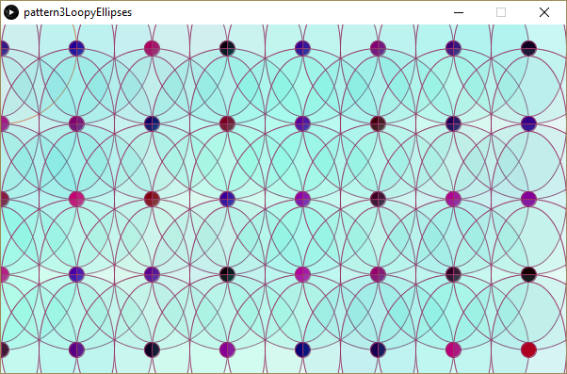
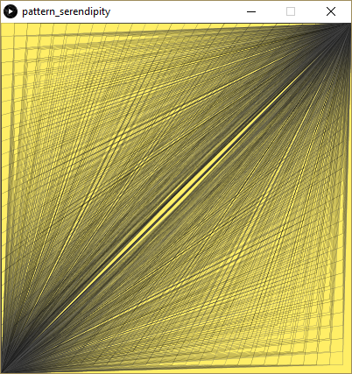

Slide 22
Variable Scope
Variables can be declared anywhere in the sketch. The concept is called scope.
Global variables are accessible anywhere in the sketch. Declared at top of program.
Local variables are limited to the code block in which they reside.
Example: a loop function where a variable is declared for that block. Try example 6-7.
Advice on handling scope: Try to place variables where they are used because it is more efficient and less confusing. Some programmers, however, do like to see most of their variables at top. Therefore…it just depends.

Slide 23
Off-topic
Off-topic. I just thought I’d share the inverted round corner.
rect( 40, 50 , 20, 20,-20);

Slide 24
Quick Access to looping in draw
Page 107
Example 6-8
//Note lines do not appear 1 at a time
//even if you change framerate to 1
//Why????
void setup() {
size(300,300);
frameRate(1);
}
void draw() {
for (int y=0; y<height; y +=10) {
stroke(0);
line(0, y, width, y);
}
}
// Line one at a time.
// Based on chapter 4 type of animation.
// Move background into draw to see result.
int y = 0;
void setup() {
size(300, 300);
background(255);
frameRate(5);
}
void draw() {
line(0, y, width, y);
y += 10;
}
Exercise 6-5
//one at a time with loop
//following model from textbook
// Variable controlling where it ends
int endY;
void setup() {
size(300, 300);
frameRate(5);
endY = 0; //but works without this
}
void draw() {
background(255);
// y goes from 0 to whatever endY is
for (int y = 0; y < endY; y += 10) {
stroke(0);
line(0, y, width, y);
}
// Increment endY
endY += 10;
// reset endY back to 0 if it gets to the end
if (endY > height) {
endY = 0;
}
}

Slide 25
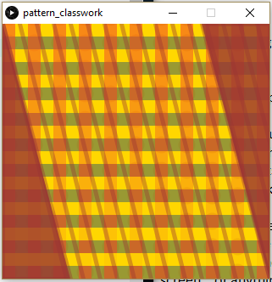
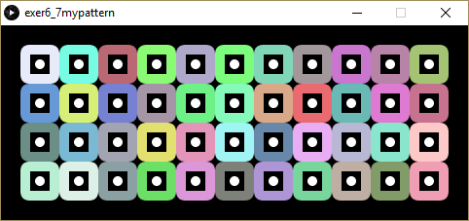
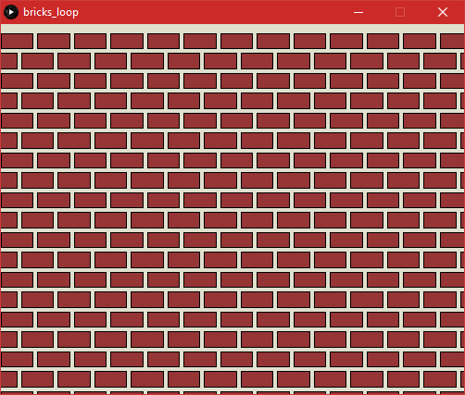
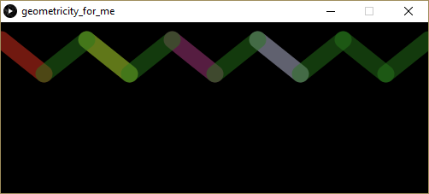

Slide 26
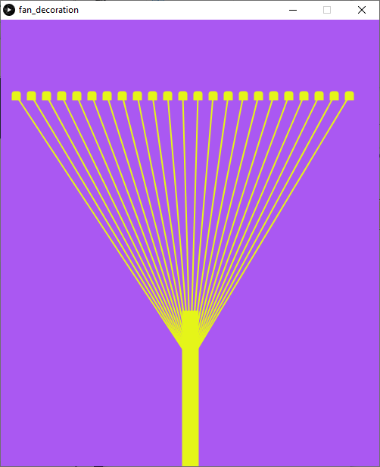
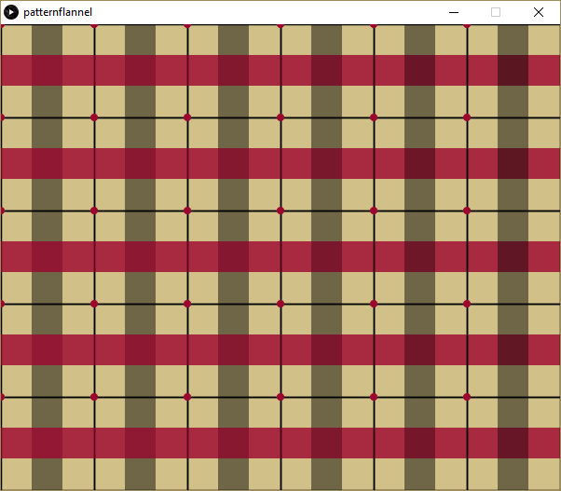

Slide 27
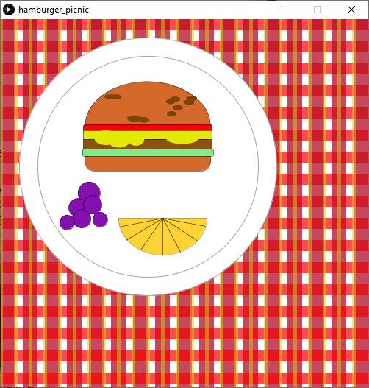

Slide 28
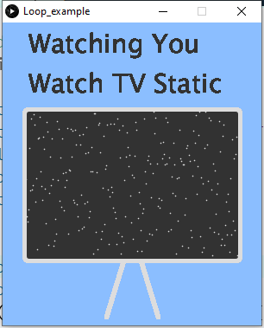
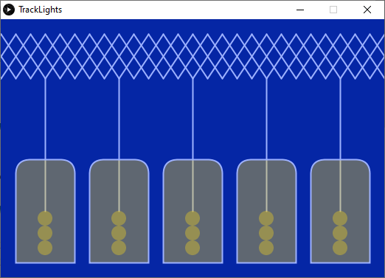
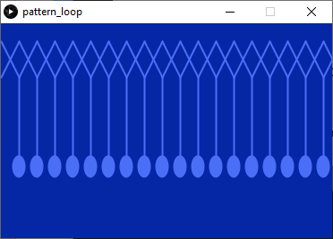
int xpos = 0 ;
int spacer = 20 ; //distance apart
int yStart = 20 ;
int yEnd = yStart+ 50;
size(520, 350);
for ( xpos = -60 ; xpos <width ; xpos += spacer ) {
line(xpos, yEnd, xpos+40 , yStart);
line(xpos, yStart, xpos+40, yEnd);
}

Slide 29
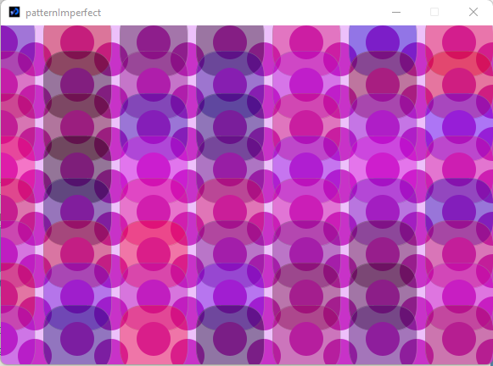
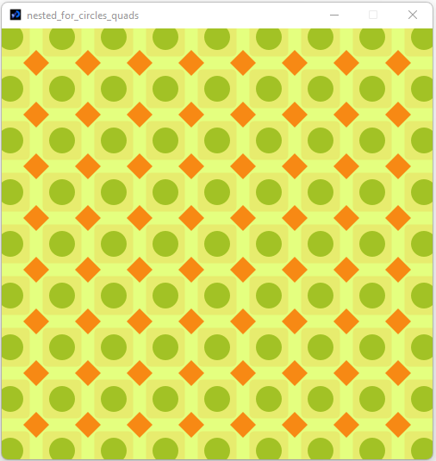
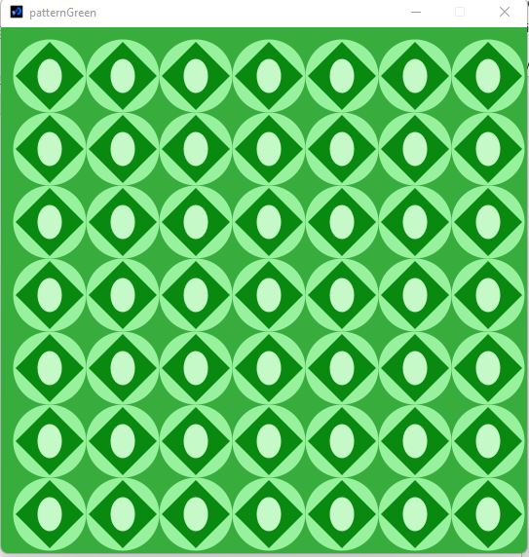

Slide 30
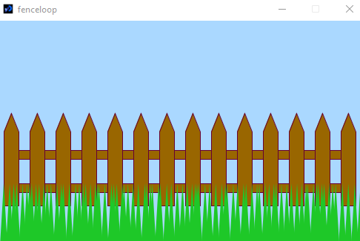
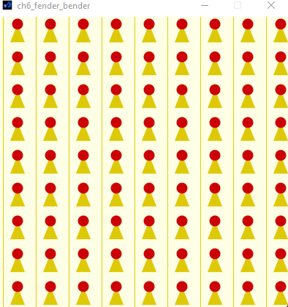
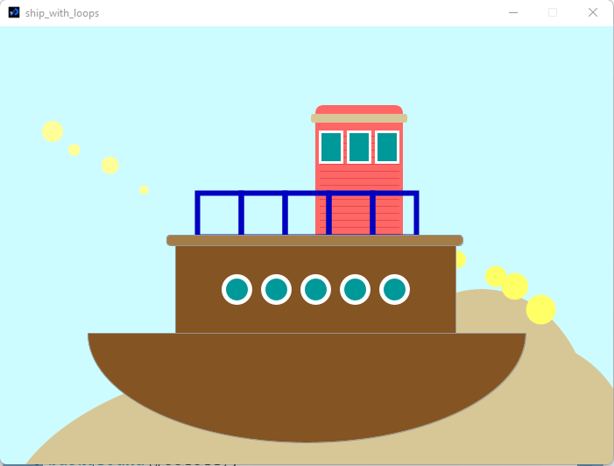

Slide 31
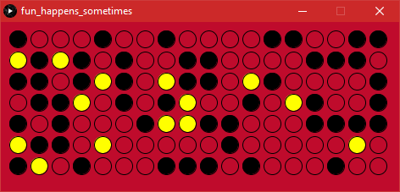
Controlled Randomness
A remix from funprogramming.org #18.
First, let’s fork #18 by creating red, yellow, green strokes depending on the random number. (Use else if instead of nested)
Simply a grid but allows 3 different fill colors based on whether random number is between 90-100, then 50-89, or 0-49.
Similar to grade & discount programs from Chap 5.
//Overall goal: in rare cases, paint using yellow color
void setup() {
size(470, 200);
background(191,11,44);
noLoop(); //delete for animation
}
void draw() {
for(int x=20; x<width-20 ; x+=25) { //extra 20 to frame properly
ellipse(x, 20, 20, 20);
}
}//end draw

