Slide 1
Chapter 8
Objects

Slide 2
In Chapter 8 you will learn:
How to put data and functionality together
Definitions of object and class
How to write classes
How to create objects
How to use tabs to separate info

Slide 3
Object-oriented programming (OOP)
… is a programming model constructed around objects. It separates data into objects and describes object contents and behavior through the declaration of classes

Slide 4
Everyday objects
In Processing, been using all along (variables, functions, loops, etc.) Now more efficiently organized.
In life, YOU are an object. - name - characteristics - actions
A book is an object. A plant is an object. A pencil is an object. Etc.

Slide 5
Moving closer to programming…
An object’s template is considered a class. For instance, each car can have different characteristics and functions.
A class acts as a category of objects. (defines all the common properties of the different objects that belong to it.)
What are the properties of a car such as this? Also, what can it do?

Slide 6
Definition of Class
A body of code that exists independently of the main body of code from which it is referenced.
It defines a set of properties & methods that are common to all objects of one type.
It is similar to a function, but usually has more than a singular purpose. It can have many functions.

Slide 7
We are going to work in reverse order by discussing how to use an object before how to make one.
My reason is that this code is more like what you’ve been writing.

Slide 8
Using an object requires 3 steps:
Declare the object
Initialize an object
Call the methods (i.e. use it)

Slide 9
Using the object: A simple sketch with an item that displays and moves:
Car myCar;
void setup() {
myCar = new Car();
}
void draw() {
background(255);
myCar.move();
myCar.display();
}
Declare the object
Initialize an object
Call the methods

Slide 10
Creating the class
Tip: New to OOP? Start with a former sketch. Then rewrite with objects. Make no functional changes. KISS. (i.e. keep it simple scholar)
Each class must have 4 elements
Name –
Data –
Constructor –
Methods –

Slide 11
Details of creating a class
Name – Good to start with caps to distinguish from variables. Use camelCase naming. Then start curly bracket.
Data – a collection of variables. Each instance of an object contains these variables.
Constructor – a special function inside of a class that creates the instance of the object. Give instructions on setting up. When called, it uses the new operator , as in: Car myCar = new Car();
Methods – add all kinds of functionality such as name, return type, arguments, & code body.

Slide 12
Details of using an object
Declaring an object variable. (a variable of complex data type) - holds both variables and functions. - unlike primitive variables that hold only one data type.
Initialize it. Initialize it by giving it a value. - Must construct object with the new operator.
- This line calls the constructor; and includes all of object’s variables.
- Remember primitives can be initialized without value. What happens if you don’t initialize an object?
Using an object. This involves calling functions that are built into that object. AKA methods. - Also, notice the dot notation syntax. variableName.objectMethod(method arguments);

Slide 13
And now… Are you down with OOP? The ball again! We’ll do it from scratch.

Slide 14
We will start with example 8.1. Then remix it. Then do another from scratch

Slide 15
Example 8.1 puts all together
What does author say about where to place the class?
A superfluous explanation of Example 8.1 , starting with the creation of the class.
Define a class
Using an object
A class is created (preferably in a separate tab) of a simple car.
#1 The class is called Car.
#2. It has 4 variables: c, xpos, ypos and yspeed.
#3 The constructor is created where the variables are initialized or given values.
#4. Two functions – display() and move() are created.
On the main screen:
#1 A Car object is declared as a global variable. The object is called myCar, like this: Car myCar;
#2 Inside setup, the car object is initialized as MyCar = new Car();
#3 Inside draw, both the move() & display() methods are called, using the dot syntax notation, like this: myCar.display()

Slide 16
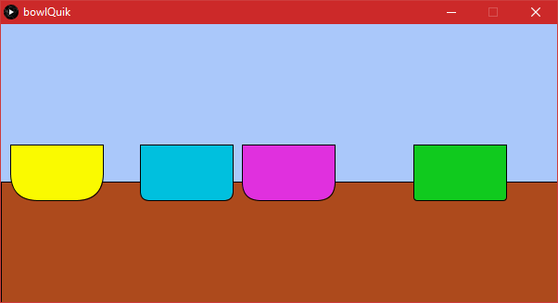
Challenge?
Create a class for a bowl object
These are sitting on a brown shelf. (irrelevant)
The color, radius for roundness, and x position vary

Slide 17
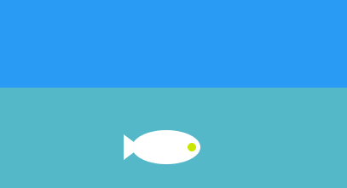
A Fish Instead
Let’s look at another example
Define a class
Using an object
Start with only display() function
Create without looking at code
//the data or variables
class Fish {
float fishX ;
float fishY ;
float fishSize ;
float speed;
//the constructor
Fish( ) {
fishX = 50;
fishY= 100;
fishSize =120;
}
//The functionality or methods
void display() {
//In sequence of: the tail, the body, and the eye
triangle(fishX-(fishSize*.375), fishY, fishX -(fishSize*.625), fishY + (fishSize * .1875),
fishX-(fishSize*.625), fishY-(fishSize * .1875));
ellipse(fishX, fishY, fishSize, fishSize/2);
ellipse(fishX+(fishSize*.375), fishY, fishSize/8, fishSize/8);
}
void swim() {
//Please create the swim method
}
}//end of class
Fish tastyFish;
void setup() {
size(500,350);
tastyFish = new Fish();
}
void draw() {
background(200);
tastyFish.display() ;
tastyFish.swim();
}

Slide 18
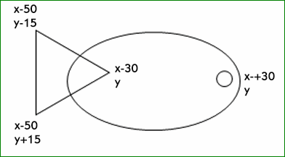
Original Fish Anatomy
…but I later changed the numbers to be proportional

Slide 19
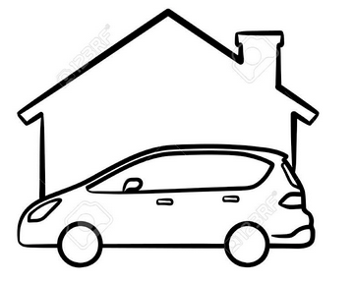
Add a House Class to exer 8.2
You may keep it simple if you’d like.
For the house class, create a simple box for the house. And maybe a triangle roof, if time.
Change myCar.move() to stop and stay in front of house.

Slide 20
Discussion of Example 8.2 (p.153)
Rewrite constructor to accept arguments.
Car(color tempC, float tempXpos, float tempYpos, float tempXspeed) {
c = tempC;
xpos = tempXpos;
ypos = tempYpos;
xspeed = tempXspeed;
}
Guidelines for temp variable name:
Any name is OK, such as “temp” or “x_”
Be consistent

Slide 21
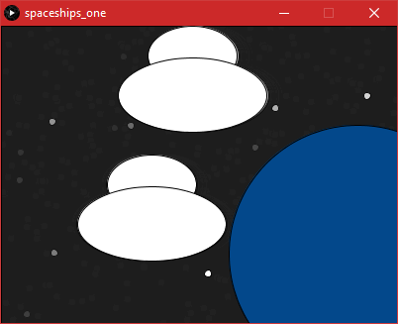
Exer 8.4 Object Creation
My idea came from this PNG image:
Spaceships leaving earth as they jitter/jiggle about among the stars
This is my simple version, using FunProgramming stars for convenience.
Your challenge: Use it as inspiration and do anything to practice at home.

Slide 22
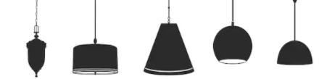
Object Creation Challenge #1
This is a PNG example.
Suppose you had to draw ceiling lamps different colors and styles. I’ve created a simple one.
Modify my lamp to make it a function.
Make a function for another simple style and call the functions in the main program
My starter example and code.
size(600, 300);
background(50);
rectMode(CENTER);
//no stroke for the lightbulb
noStroke();
fill(#FCFFAF);
ellipse(50, 120, 75, 55);
//need variable for color, width, and xloc.
stroke(0);
fill(#6F8CD8);
rect(50, 0, 10, 140); //stem
rect(50, 90,75, 60, 20,20, 0, 0); //the tracklight

Slide 23
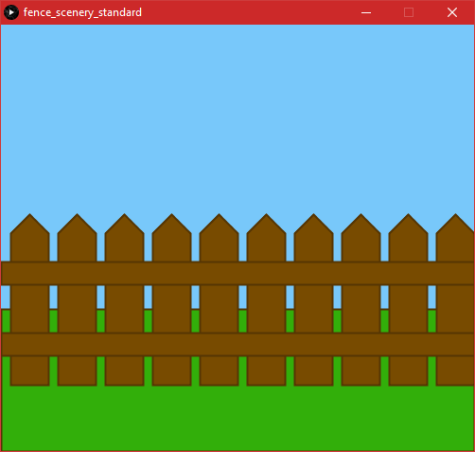
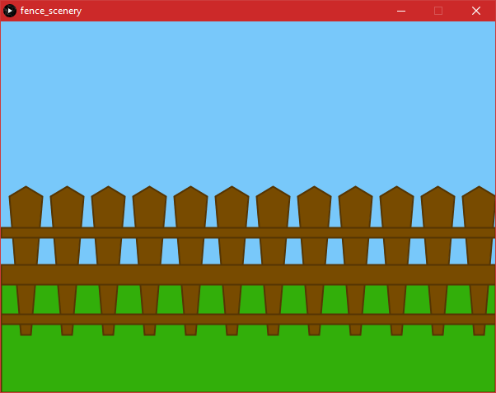
Object Creation Challenge #3
Two different versions of my fence. Make a class for any kind of fence you wish. I used begin/end shape. You can use any shape you prefer.

Slide 24
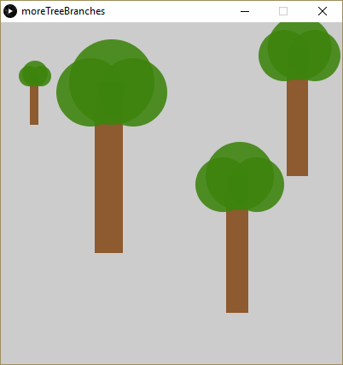
Object Creation Challenge #4
Your Challenge. Suppose you wanted several items in different locations, sizes, and/or colors?
void drawTree( ) {
noStroke();
//trunk
fill(#8E5A2F);
rect(x-(size/5), y, size/3, size*2);
//branches
fill(c, 225 ); //not too much transparency
ellipse(x,y, size,size); //everything's anchored to this
ellipse(x-size/4, y+size/8, size/1.25, size/1.25);
ellipse(x+size/4, y+size/8, size/1.25, size/1.25);
}

Slide 25
Object Creation Challenge #5
This is a GIF file that I found as an example. You don’t have to draw this particular fish, but..
Your challenge: is to draw a new fish class and add it to mine. Then make it swim faster than mine.

Slide 26
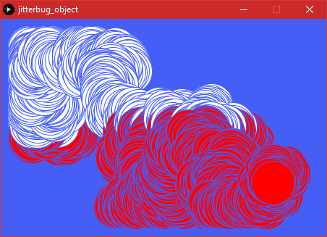
Object Creation Challenge #6
class Jitterbug {
float x;
float y;
int diameter;
float speed = 5;
Jitterbug(float tempX, float tempY, int tempDiameter) {
x= tempX;
y= tempY;
diameter = tempDiameter;
}
void move() {
x += random(-speed, speed );
y += random(-speed, speed);
x = constrain(x, 40, width-40);
y = constrain(y, 40, height-40);
if (y >= 150) {
fill(#ff0000);
}else {
fill(255);
}
}
void display() {
ellipse(x, y, diameter, diameter);
}
}//end of class
Jitterbug bug;
void setup() {
size(450, 300);
bug = new Jitterbug(40, 40, 60 );
background(#455EF5);
}
void draw() {
stroke(#455EF5);
bug.display();
bug.move();
}
Your challenge: Fork the jitterbug code in any way you wish.

Slide 27
Special Challenge:
Object Oriented Programming
Your challenge: Show us anything that you’ve been practicing on that deals with creating objects. It has to be original and not from the textbook.

