Slide 1
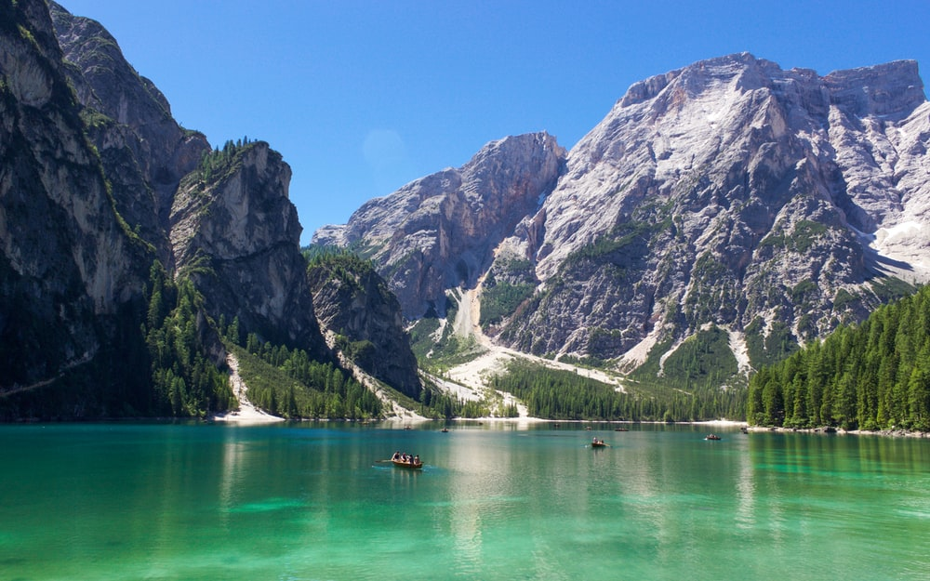
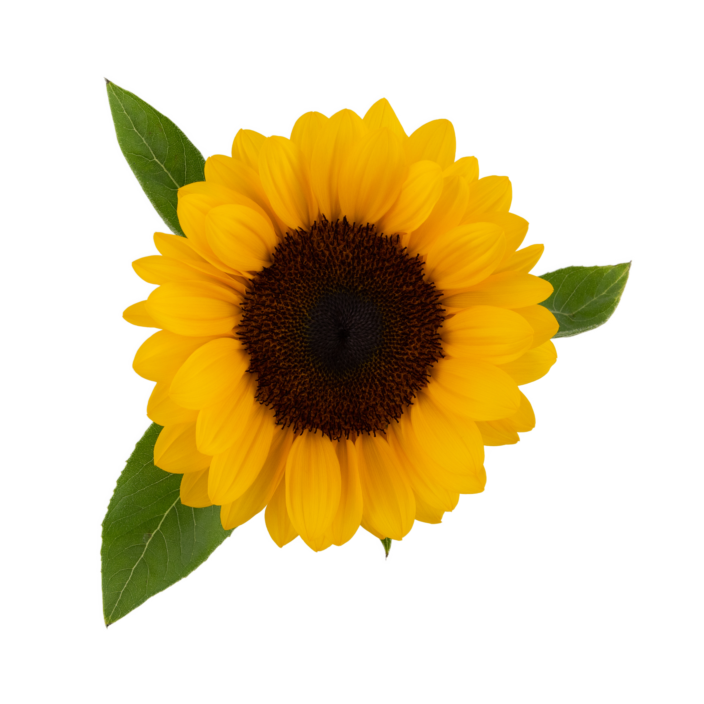
Chapter 15: Images
Sections 1, 2, 3

Slide 2
Getting Started
4 steps to draw an image to the screen.
Add file to data folder
Create the PImage variable
Load the image into the variable with loadImage()
Draw the image image() function
PImage is a class for loading and displaying an image.

Slide 3
Practice Activity
Example 15-1. Use different image from the textbook.
Next, control the height & width with the mouse.
To get the image:
Drag file into Processing window, or
Click SKETCH>Add file, or
Create the data folder and add file manually.
Other considerations
The files accepted are GIF, JPG, PNG & TGA
Spaces are OK, but the file name is case sensitive.

Slide 4
Resizing an Image
Problem: Using a 4th & 5th parameter to resize an image does not work consistently. e.g.
image(img, 0, 0, width/2, height/2)
Problem: Using a 4th & 5th parameter to resize an image does not work consistently. e.g. image(img, 0, 0, width/2, height/2)
Solution: There is a consistency issue with how images are rendered when sized that way.
Ideally, should resize in image editor.
A workaround is to calculate by using image dimensions. e.g. image(img, 0, 0, 240/2, 190/2)
The proper function is with resize(). https://processing.org/reference/PImage_resize_.html

Slide 5
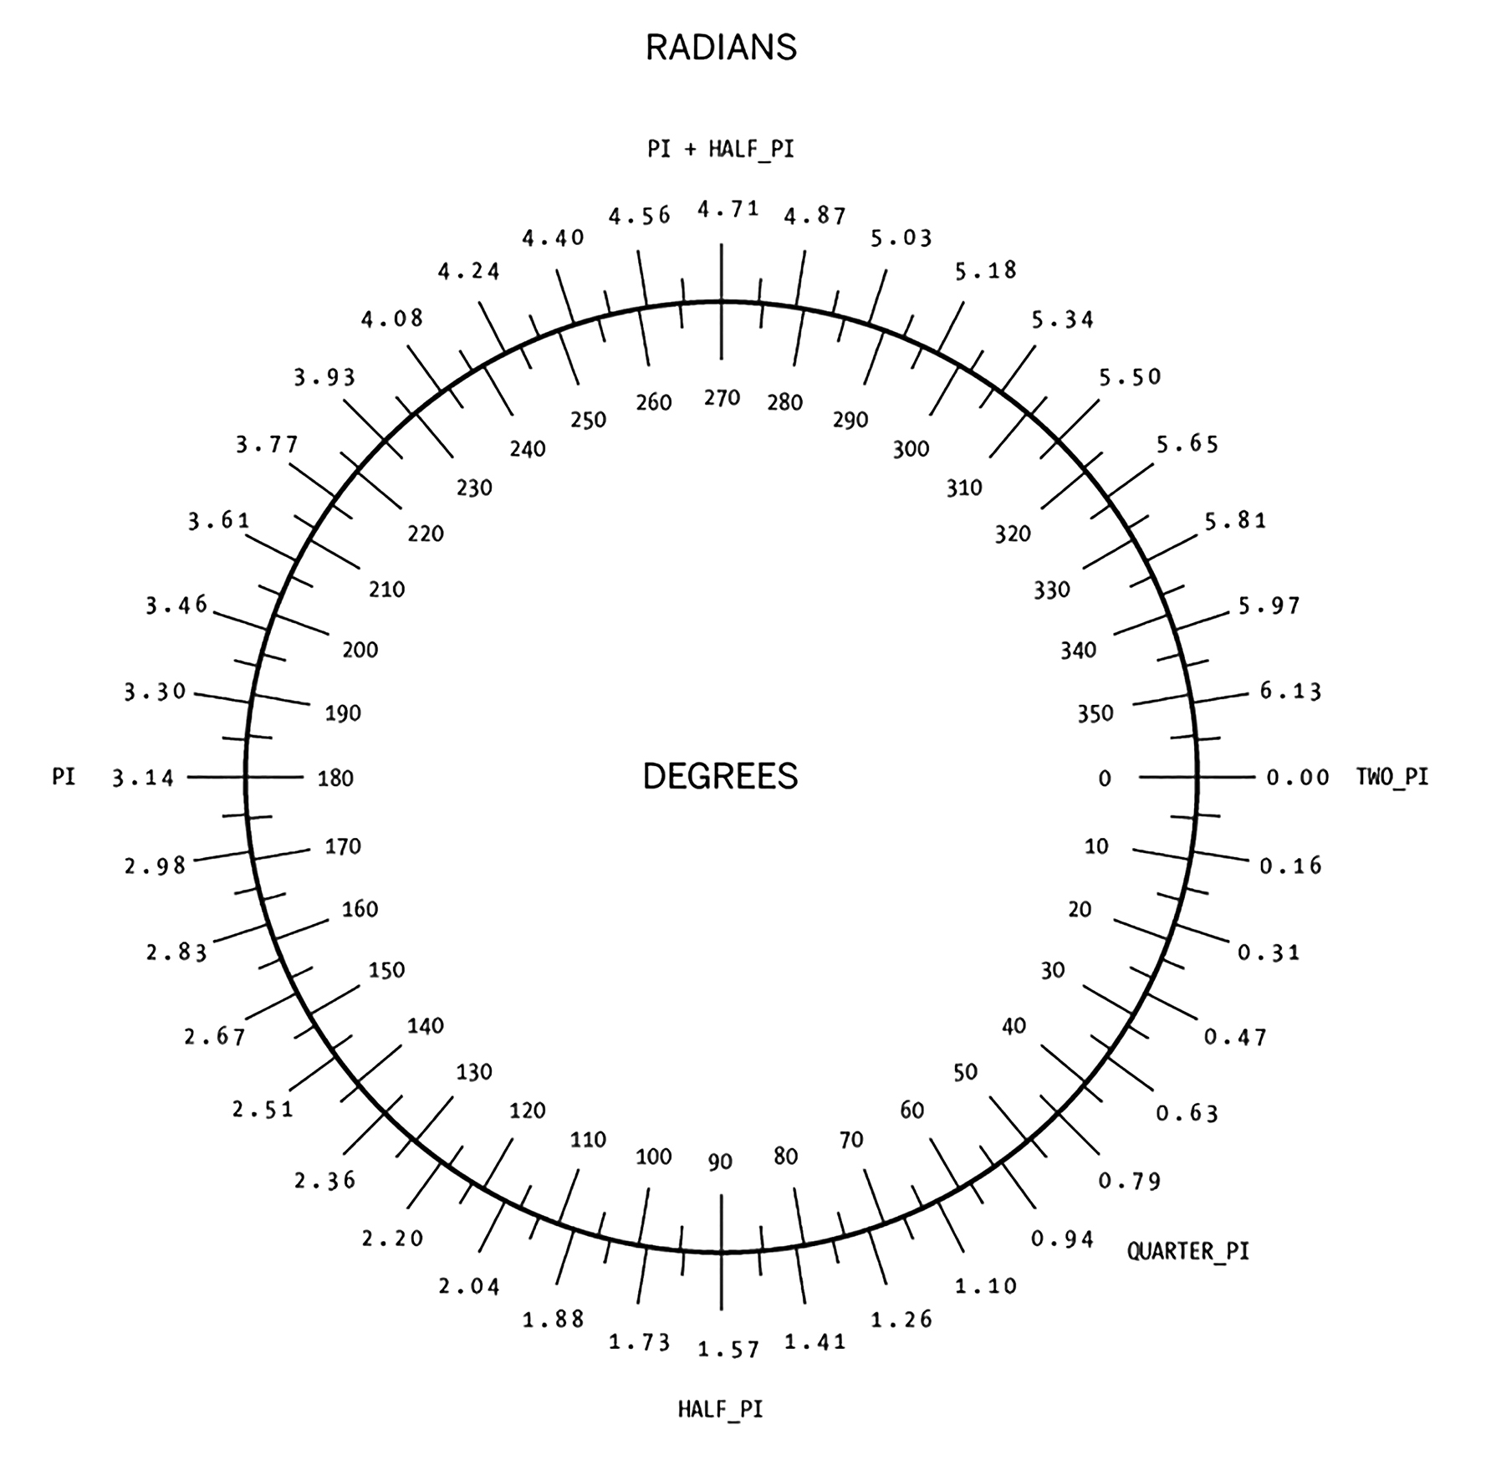
Animate
Use translate and rotate to animate an image
Increment or decrement.
Remember that rotate is measured in radians
Change mode if desired: rectMode(CENTER)

Slide 6
Another Practice Exercise
Open your Example 15-2 and let’s examine code.
Use your own picture from www.pngimg.com or www.freepngimg.com
For a remix, add JPG picture as background()

Slide 7
Syntax of Tint and Alpha
About Alpha
Alpha is from 0-255, where:
0 is completely transparent
255 is completely opaque
1 value : tint(brightness)
2 values: tint(brightness, alpha)
3 values: tint(r, g, b)
4 values: tint(r, g, b, alpha)
Tint

Slide 8
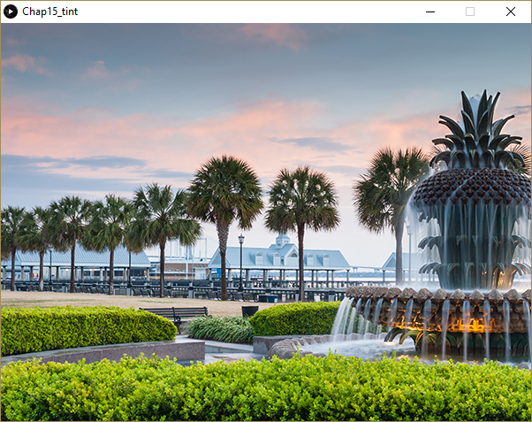
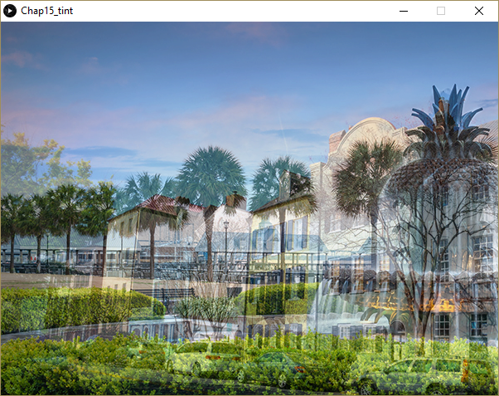
First Example
Original
tint(255, 100);
Shows rainbow row behind waterfront pineapple.

Slide 9
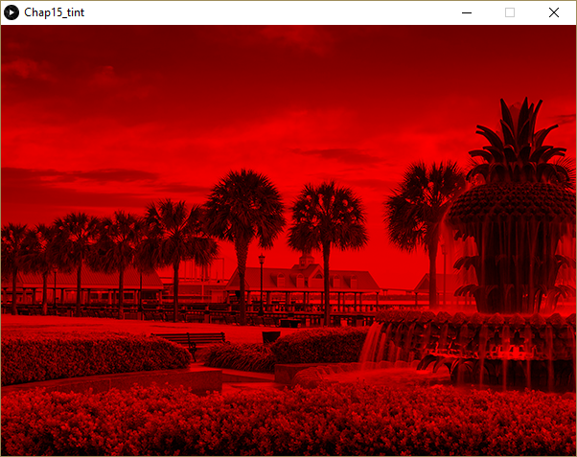
Another Example:
tint(255, 0, 0);
Or
tint(#FF0000);
Shows a red tint with no transparency

Slide 10
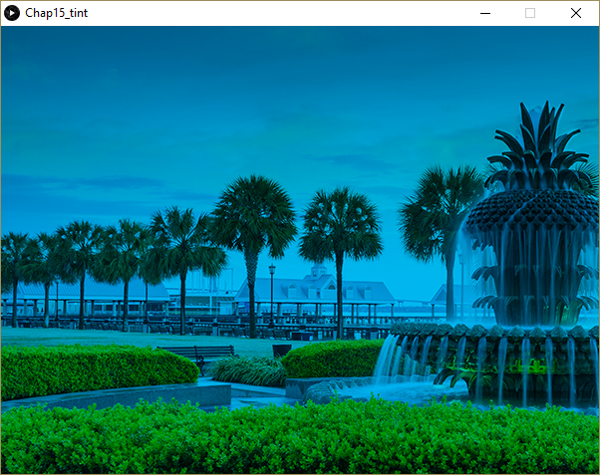
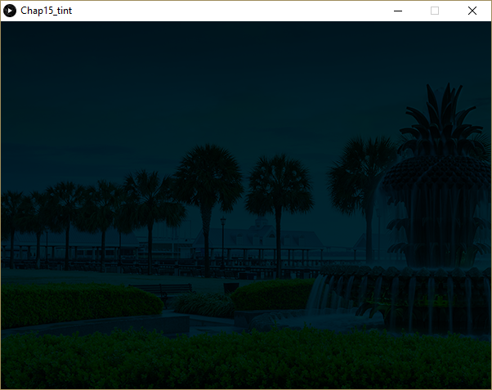
Another Example:
background(0);
tint(0,200,255 );
…blue/green with no transparency
background(0);
tint(0,200,255,50);
…blue/green with high transparency against black background.

Slide 11
Interesting comparison to “the ball”
//see page 86. Reverse polarity
PImage img;
float transparency = 255;
float speed = 1;
void setup() {
size(400, 400);
img = loadImage("flower_red.png");
}
void draw() {
background(0);
transparency = transparency - speed;
tint(255, transparency);
image(img, 100, 80);
if ((transparency < 0) || (transparency >255) ){
speed = speed * -1;
}
}
Let’s go crazy with it!
PImage img;
void setup() {
size(400, 400);
img = loadImage("flower_red.png");
}
void draw() {
background(0);
strokeWeight(4);
fill(#00dd00);
//make frame
//using dot syntax to access image properties
rectMode(CENTER);
rect(200, 200, img.width+40, img.height+40);
//yeah, I know this is an overkill
fill(#ffee00);
noStroke();
ellipse(200, 200, img.width+20, img.height+20);
fill(#eedd00);
imageMode(CENTER);
image(img, 200, 200);
}

