Slide 1
Chapter 2
How to Code, Test, & Validate Webpages

Slide 2
Objectives
Applied
Use a text editor like VS Code to create, edit, and test HTML and CSS files.
Test an HTML document that’s stored on your computer or a local server by loading it into a browser.
Use the W3C HTML and CSS Validation Services to validate HTML and CSS files.
Knowledge
Describe the use of the head and body elements in an HTML document.
Describe these types of HTML tags: opening, closing, and empty.
Describe the use of attributes within HTML tags.
Describe the use of HTML comments and whitespace.

Slide 3
Basic structure of an HTML document

Slide 4
A Simple HTML Document
<!DOCTYPE html>
<html lang="en">
<head>
<meta charset="utf-8">
<title>Type your title</title>
</head>
<body>
</body>
</html>

Slide 5
Working with tags
Two elements with opening and closing tags
<h1>San Joaquin Valley Town Hall</h1>
<p>Here is a list of links:</p>
Two empty tags
<br>
<img src="logo.gif" alt="Murach Logo">

Slide 6
Correct nesting of tags
Correct nesting
<p>Order your copy <i>today!</i></p>
Incorrect nesting
<p>Order your copy <i>today!</p></i>

Slide 7
An opening tag with attributes
An opening tag with one attribute
<a href="contact.html">
An opening tag with three attributes
<a href="contact.html" title="Click to Contact Us" class="nav_link">

Slide 8
Coding tags with attributes
How to code an empty tag with attributes
<img src="logo.gif" alt="Murach Logo">
How to code a Boolean attribute
<input type="checkbox" name="mailList" checked>

Slide 9
Attributes for identifying elements
An opening tag with an id attribute
<div id="page">
An opening tag with a class attribute
<a href="contact.html" title= "Click to Contact Us" class="nav_link">

Slide 10
Common HTML errors
An opening tag without a closing tag.
Misspelled tag or attribute names.
Quotation marks that aren’t paired.
Incorrect file references in link, img, or <a> elements.

Slide 11
Opening a webpage on your local computer
Use the features of your text editor or IDE, like Live Server with VS Code. (We’ll discuss next week)
Find the file in your file explorer. Then, double-click on it to open it in your default browser. Or, right-click on it and use the Open With command to select the browser.

Slide 12
How to test and debug a web page
How to test a web page
Check the contents and appearance of each page.
Click on all of the links on each page to make sure they work properly.
After you’ve tested your web pages on one browser, test them on the other browsers that your users may be using.
How to debug a web page
To find the causes of your errors, you can use Chrome’s Developer Tools. This tool shows you how the CSS relates to the HTML. (We’ll discuss next week)
After you find the cause of an error and fix it, you test the page again. To do that, you can switch to the browser from your text editor or IDE and then click the Refresh or Reload icon.

Slide 13
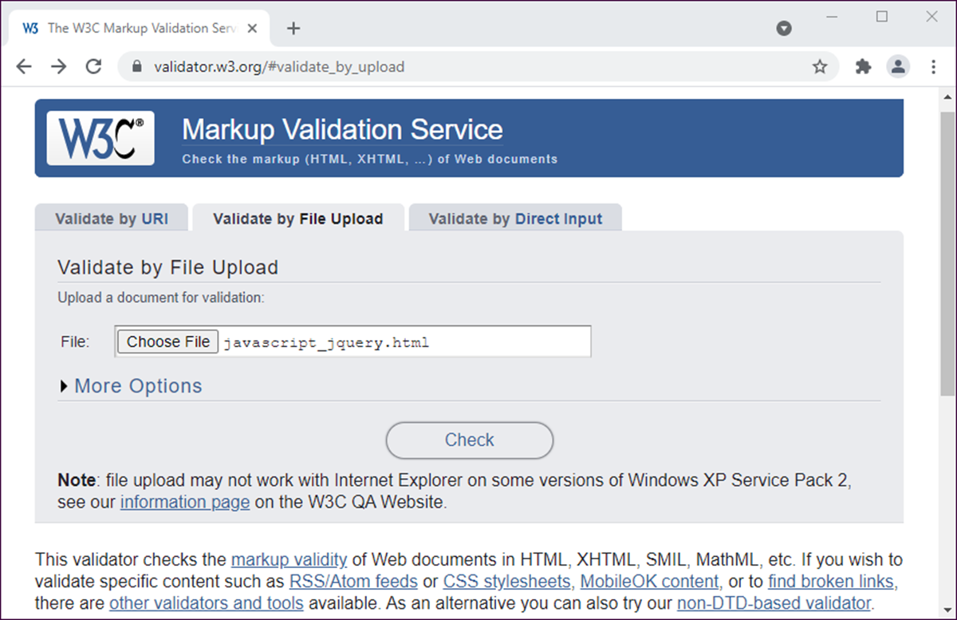
The home page for the W3C Markup validator

Slide 14
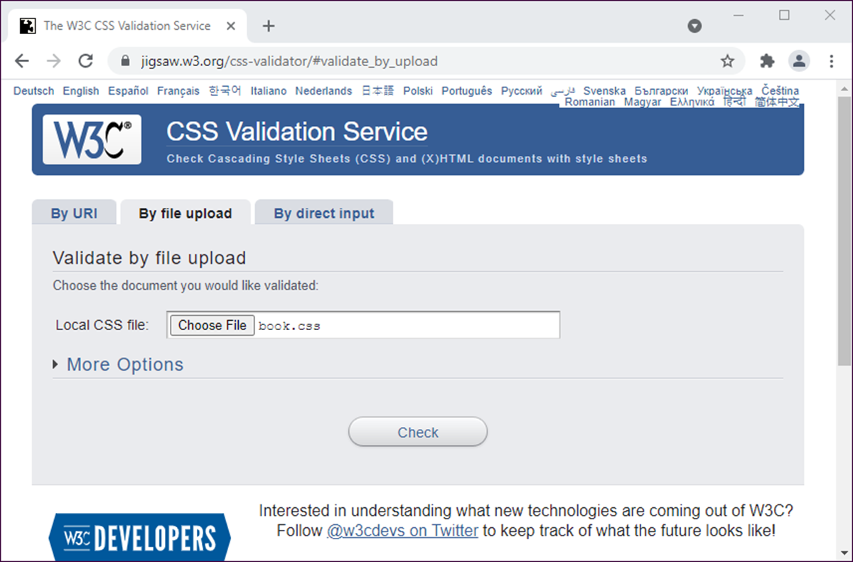
The home page for the W3C CSS validator

