Slide 1
Graphic Design & Digital Media
October 11th
Value-Added Perspectives

Slide 2
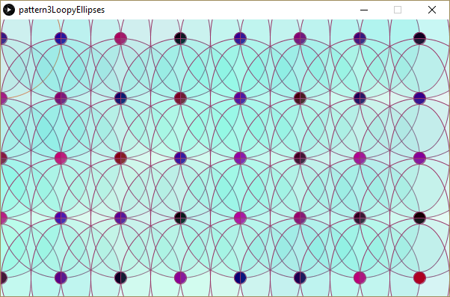
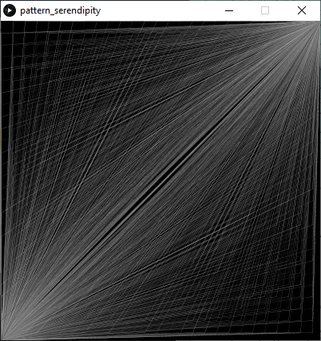
Slide from Chapter 6 along with code.
//keep static top right and bottom left
size(400,400);
background(0);
for(int y = 0; y<=height; y += 15) {
for(int x = 0; x<=width; x +=15) {
strokeWeight(.2 );
stroke(random(50,200) );
line(x,y,400,0 );
line(0,400,x,y);
}
}
//Note control of Random colors
//Note Ovals
int xloc= 0;
int yloc= 0;
int size= 160;
int spacer = size/2; //This causes 1/2 overlapping
void setup() {
size(900,470);
background(255);
}
void draw() {
noLoop() ; //to keep random coloring from blinking
stroke(#ff6633);
for(int xloc=0 ; xloc<=width ; xloc += spacer) {
for(int yloc = 25; yloc <= height; yloc += spacer) {
fill(random(150),random(200,255), 200, 30);
ellipse(xloc, yloc, size, size);
stroke(#993366);
//smaller ellipse is oval
ellipse(xloc, yloc, size*.5, size*.9);
//Really small circle in purplish range
fill(random(200),0, random(200) );
ellipse(xloc, yloc, size/10, size/10);
}
}
save("pattern.jpg");
}

Slide 3
Boolean on/off switch
PARTS 1 & 2 OF VIDEO
https://screencast-o-matic.com/watch/cY6bVt7UgC
https://screencast-o-matic.com/watch/cY6bnj7UEK

Slide 4
More on Semester Project #1
Sample Videos
https://www.youtube.com/watch?v=eVN7AuJixGU
We will watch this together. What are some of the actions/activities that you see.
What clever use of shapes do you see?
What programming structures such as conditionals, and loops can you detect?
Open ended question: What is one more thing that you would add?
Involves two features that we haven’t used yet.
Look at the instructions in your spare time:
www.youtube.com/watch?v=g0UPwrtShUI
I watched a part of it and not sure I’d do it the same, but his way is probably better anyway.

Slide 5
More Examples
Not done in Processing, but they give ideas of how short
animated stories can be told.
Candle Love
Classic 1984
Classic Pipi
Classic Alice
Classic Christmas Carol
Morning
Slow motion love
Car crash
Commercial
Commercial

Slide 6
Eating action
moorec.people.cofc.edu/creature_eating.html

Slide 7
Translate and Rotate
Rotate –
The coordinate system is rotated around the origin by the given angle (in radians).
rotate( radians );
Translate –
Specifies how much to displace objects on the x, y, and z axes.
translate(x, y);

Slide 8
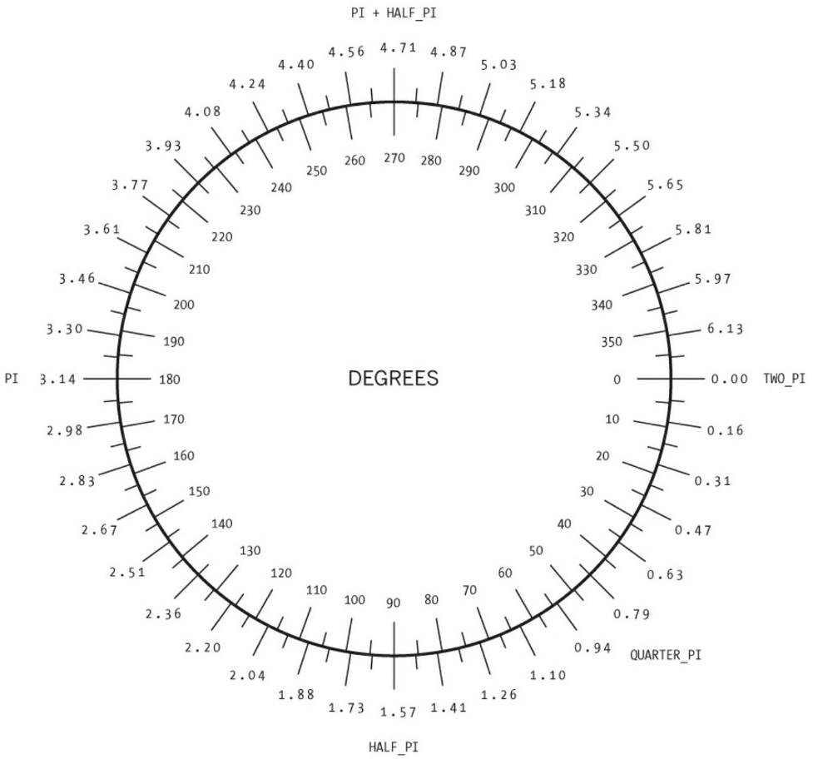
FYI

Slide 9
WILL USE:
translate
rotate
pushmatrix
popmatrix

Slide 10
Next is slide #2 from Chap 6 pptx

Slide 11
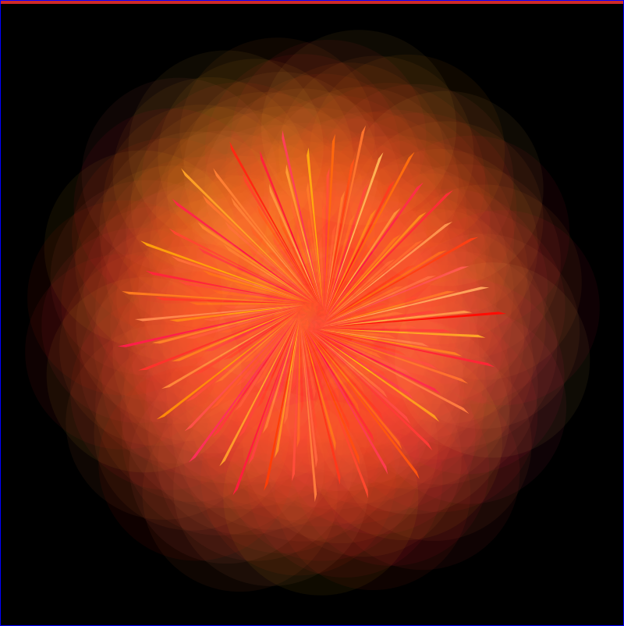



/*originally started out with creating a spiral, which
would mainly happen by translating, then incrementing the x axis and rotate a little
However I did a remix into this abstraction */
void setup(){
size(800,800);
background(0);
frameRate(5 );
}
void draw(){
noLoop();
translate(width/2, height/2);
//Now both x and y of circles are at half of screen.
//Note that "i" starts out at 250.
for (float i = 0; i <250; i++) {
//strokeWeight(.25);
fill(255,random(200), random(1, 100), 15);//barely visible big circles
rotate(1);
ellipse(i, 0, 250, 250);
noStroke();
//unplanned triangle
fill(255,random(200), random(1,100) );
triangle(i-5, 5, 10, 15, i+5, 8);
}//end of for
}
Run the code!
Copy & paste to Processing.
Fork the code!
Try making some changes.

Slide 12
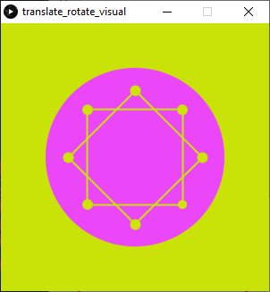
Another Example
float x = 0;
void setup(){
size(300,300);
frameRate(20);
}
void draw(){
background(#C9E309);
noStroke();
fill(#EB46F7 );
translate(width/2, height/2);
ellipse(0, 0, 200, 200);
for(float i = 0; i < 8; i++) {
fill(#C9E309);
strokeWeight(2);
rotate(QUARTER_PI);
fill(#D4E30E );
ellipse(x, 0, 10, 10);
//lines
stroke(#C9E309);
line(x,0, x-75, 75);
x=x+.1; //speed
//keep var x in circle; was trial & error
x=constrain(x, 0, 75);
}//end for
}

Slide 13
Wednesday
Timelines to tell a story
-Funprogramming.org #91
-Note that it uses functions (Chap7)
Adding Sounds
-Read a few pages of Chap20
-Note that it uses libraries
https://www.soundeffectsplus.com

