Slide 1
Review of Animations Follow-up to Fresh Take Presentations
Submit by 6pm today, on your assignment page.
Label it Animation exercise.
This is all about exposure. Don’t worry about getting all of it. As long is you have about 50%, it will be A.
Feel FREE to EXPLORE and go ABOVE AND BEYOND.

Slide 2
Basics of Animation Keep in mind that transitions and transformations often used with animation.
A CSS animation is an instruction to progressively update one or more CSS properties over a period of time.
Building Blocks
Keyframes— for stages and styles
Name
Stages, as a percentage
CSS Properties, defined for each stage. e.g. color, position, or transform.
Properties — assign @keyframes to elements
Assign the @keyframes
Define how animated

Slide 3
The next 3 slides provide a brief differentiation:
- animation
- transition
- transformation

Slide 4
Animation Basics
Progressively update CSS properties over a period of time and involves two basic part:
The animation code using @keyframes
Applying the animation to an element
More Information at:
https://www.w3schools.com/css/css3_animations.asp
Click for a quick perusal.

Slide 5
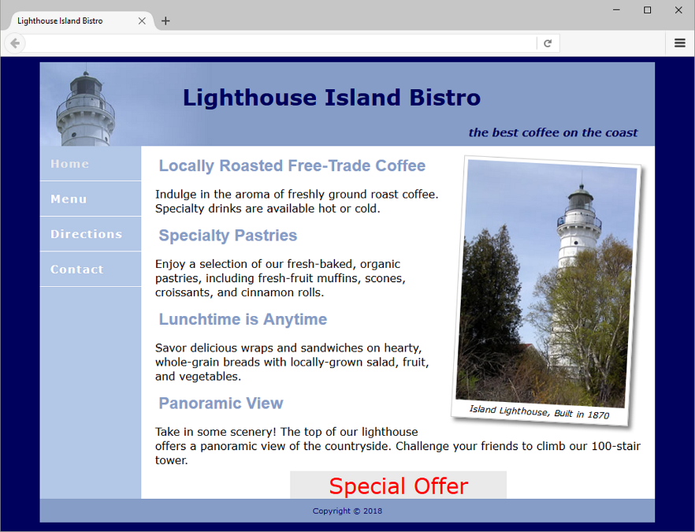
Transformation Basics
Allows you to change the display of an element with functions such as: rotate, scale, skew, and translate.
Example:
transform: rotate(10deg);

Slide 6
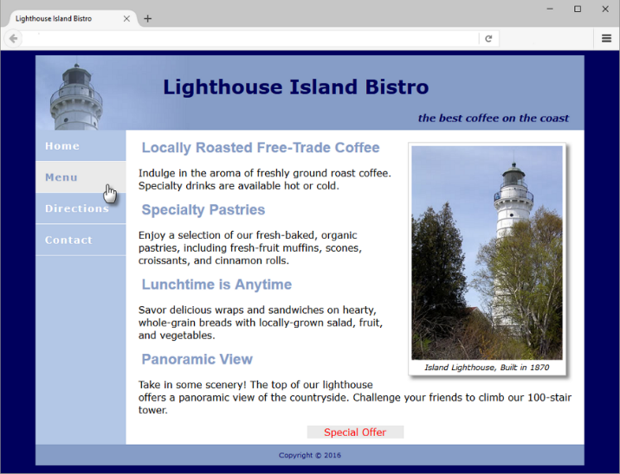
Transition
Transition provides for changes in property values to display in a smoother manner over a specified time.
Example:
nav a:hover {
color: #8090c7;
background-color: #eaeaea;
transition: background-color 2s linear;
}
It has properties such as:
transition
transition-delay
transition-duration
transition-property
transition-timing-function

Slide 7
CSS Animation Cheat Sheet
Have fun!
learn-the-web.algonquindesign.ca/topics/css-animations-effects-cheat-sheet/#animations

Slide 8
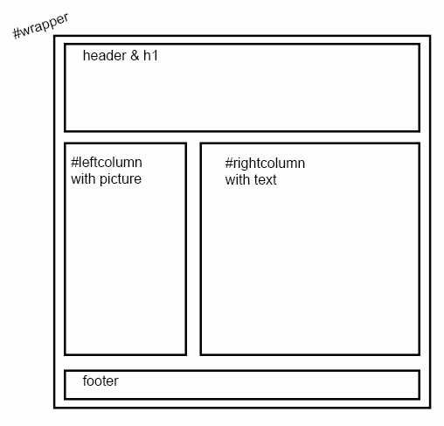
Wireframe Plan for Page
If not done yet, go to the Special Topics webpage and download the zipped file.

Slide 9
Animation Plan
Before we start with the animations, go ahead and insert the images and additional div in the HTML file according to the instructions in the comments.
Reason for dilly-dallying: This simply gives you more time to examine the structure.
Next, we will start applying animations, transformations, and transitions to the file one at a time. Below is an explanation of each file, and I will provide further information on where to paste and play!
animateONE.txt file
Purpose is to constantly change background color.
animateTHREE.txt file
A transformation so that when user hover over div, it spins.
animateTWO.txt file
Purpose is to move object in rectangular motion
animateFOUR.txt, as time permits
Purpose is to use transition to shrink picture upon hover.

