Slide 1
CSS ANimation
Jaylen Byrd

Slide 2
How it Works

Slide 3
How it Works
CSS Animation opens up a new world in terms of when it comes to design.
CSS Animation has a wide application to many different usages on a web page, including things like your nav bar, how things appear when you scroll down a webpage etc.
CSS Animation has the ability to be combined with Javascript and additionally frameworks to give your design a high quality and modern feeling to it. Having the skills of CSS Animation invokes a lot of attraction to a website as well

Slide 4
Syntax
element{
Animation-name: (animation name);
Animation properties ( animation-duration, animation-delay, animation-iteration-count, animation-direction, animation-fill-mode)
}
@keyframes (animation name){
From{ desired properites} To{ desired properties}
**you can detail what percentage of the animation that you want something to happen as well!
}

Slide 5
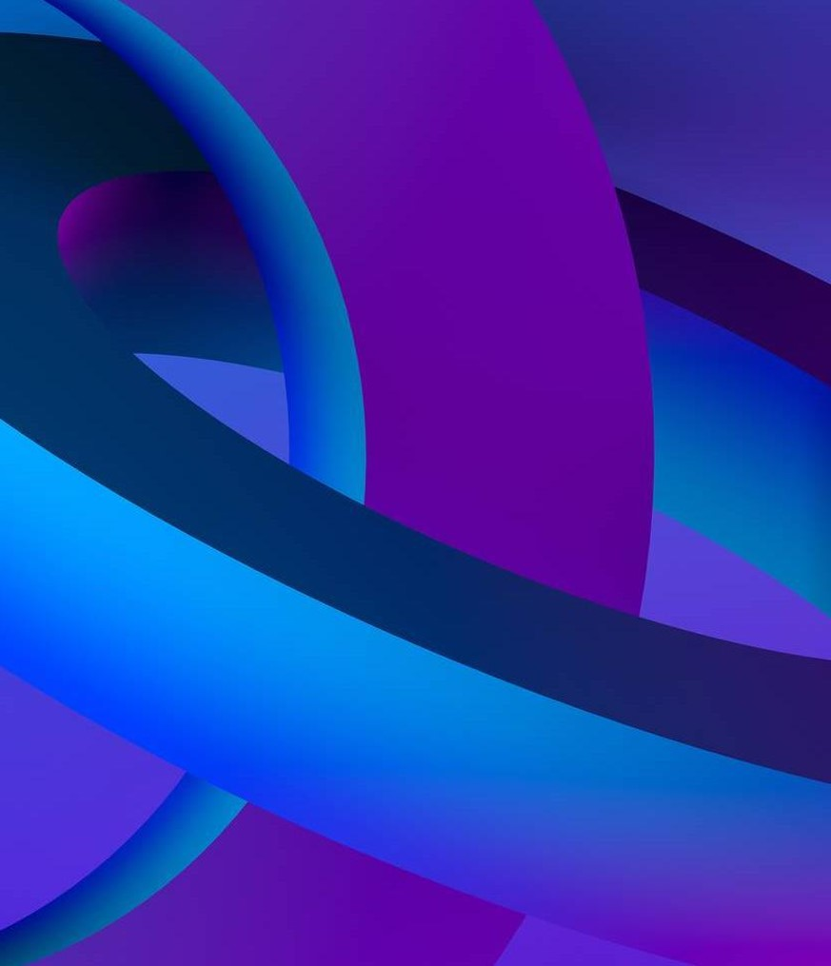
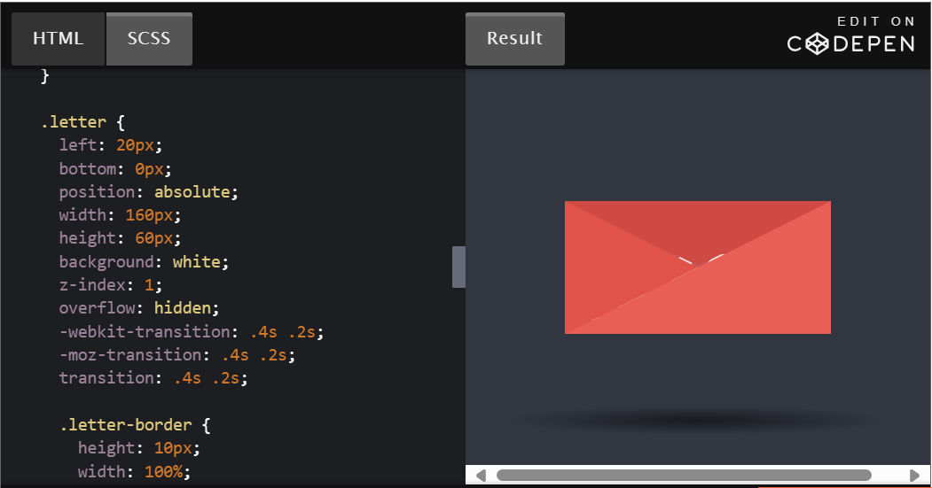
Popular Usages of
Animation
30 Creative and Unique CSS Animation Examples to Inspire Your Own (hubspot.com)

Slide 6
How does it Benefit your Work
CSS Animation is something that would be good to incorporate into your work because it usages can enhance any website and become very attractive for visitors of the site
Additionally by displaying these skills to companies, it could also improve your likelihood of a company taking interest in your website building skills, and therefore make your work more desirable by companies

Slide 7
What should you focus on with CSS Animation?

Slide 8
EFFECTIVE Animation Usages
The most common areas where you’d notice any animation on a page is within an image, navbar, or interactable element on the page.
Most of the common animation applications include
Expansion of a button on the nav bar or sub-menu
Fading of an image or element on the screen
Loading symbol for a site while content loads.

Slide 9
THANK YOU!!

