Slide 1
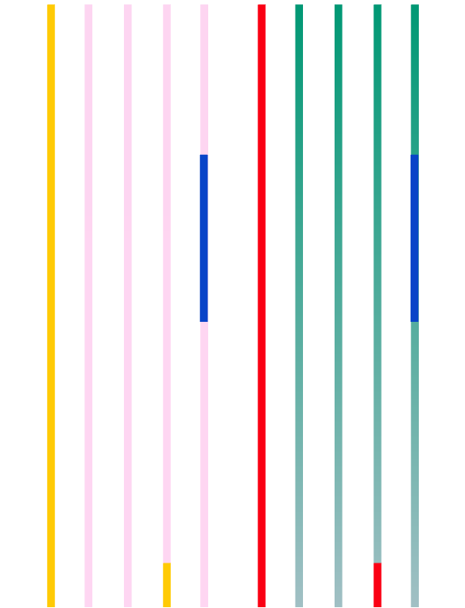
CSS Animation
By: Justin Monserrat & Jordan Schiff

Slide 2
@keyframes
DEFINITION
EXAMPLE
/* The animation code */
@keyframes example { from {background-color: red;}
to {background-color: yellow;}
}
/* The element to apply the animation to */
div {
width: 100px;
height: 100px;
background-color: red;
animation-name: example;
animation-duration: 4s;
}
When you specify CSS styles inside the @keyframes rule, the animation will gradually change from the current style to the new style at certain times.
To get an animation to work, you must bind the animation to an element.

Slide 3
Animation
Duration
Delay
Iteration
The animation-duration property defines how long an animation should take to complete.
If the property is not specified, no animation will occur, because the default value is 0s.
The animation-delay property specifies a delay for the start of an animation.
If you put, 2s, it will wait 2 seconds before starting. You can also do negative time, such as, -2s, and it will start the animation as if 2 seconds have already passed.
The animation-iteration-count property specifies the number of times an animation should run.
You can use any number values, like 3 to run it three times, or you can use, infinite, so the animation goes on forever.

Slide 4
Animation Directions
Normal
The animation is played as normal (forwards). This is the default
Reverse
The animation is played in reverse direction (backwards).
Alternate
The animation Is played forwards first, then backwards.
Alternate-reverse
The animation is played backwards first, then forwards.

Slide 5
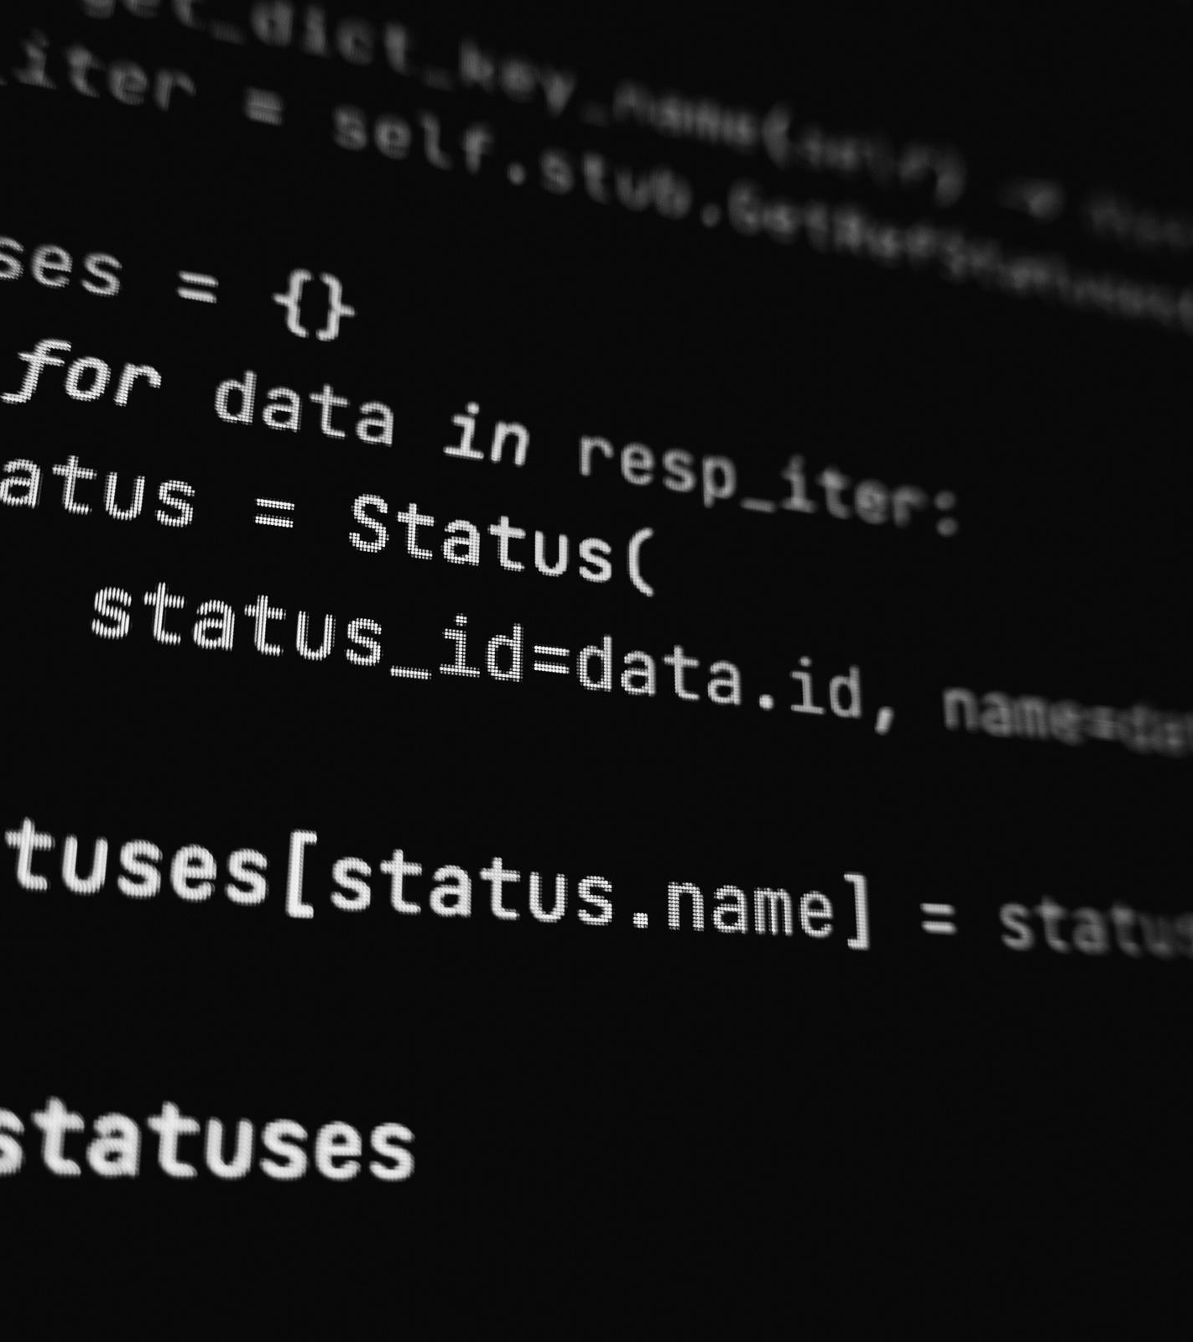
Speed Curve
The animation-timing-function property specifies the speed curve animation. It can have the following values.
Ease
Specifies an animation with a slow start, then fast, then ends slowly. This is the default.
Linear
Specifies an animation with the same speed from start to end.
Ease-in
Specifies an animation with a slow start.
Ease-out
Specifies an animation with a slow end.
Ease-in-out
Specifies an animation with a slow start and end.

Slide 6
Shorthand
div { animation-name: example;
animation-duration: 5s;
animation-timing-function: linear;
animation-delay: 2s;
animation-iteration-count: infinite;
animation-direction: alternate;
}
div { animation: example, 5s, linear, 2s, infinite, alternate; }

Slide 7
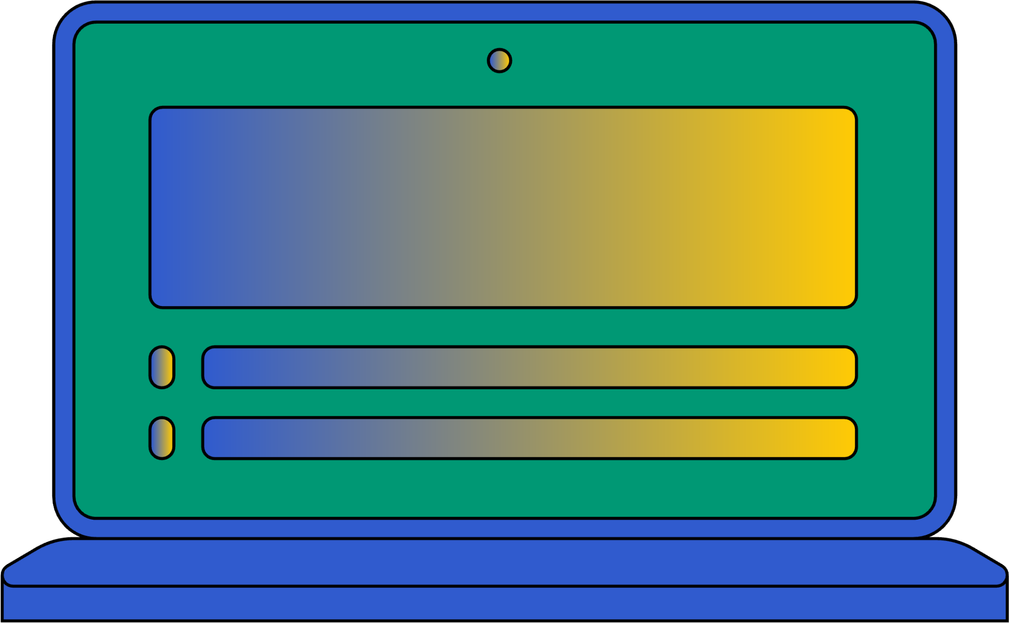
CREDITS
This presentation template is free for everyone to use thanks to the following:
SLIDESCARNIVAL
for the presentation template
PEXELS
for the photos

