Slide 1
Use OBJECT/Envelop/warp and artistic stroke for an effect similar to this
http://vectorguru.com/tutorials/011_rainbow_in_illustrator.html

Slide 2
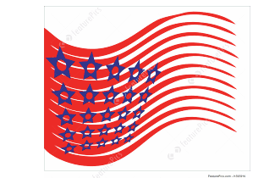
Use OBJECT/compound Path to make star & circle like this

Slide 3
Use Width tool to shape the vien of the leaf. No need to draw entire leaf

Slide 4
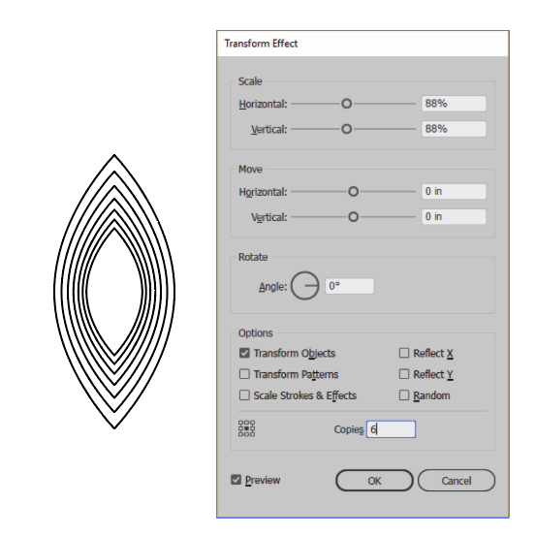
Draw oval
Use Anchor Point tool to make pointy top & bottom
Use EFFECT/Transform and Distort/Transform to do the following.

Slide 5
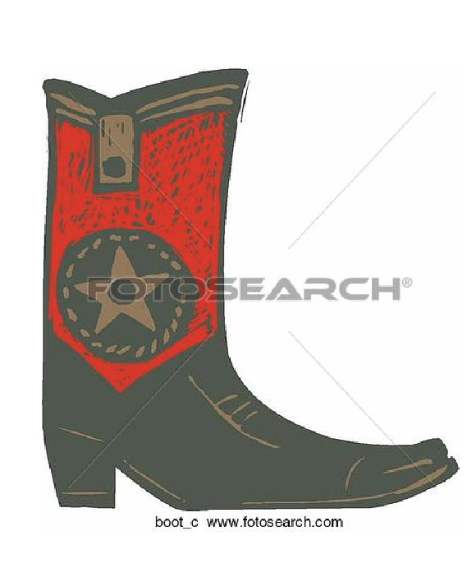
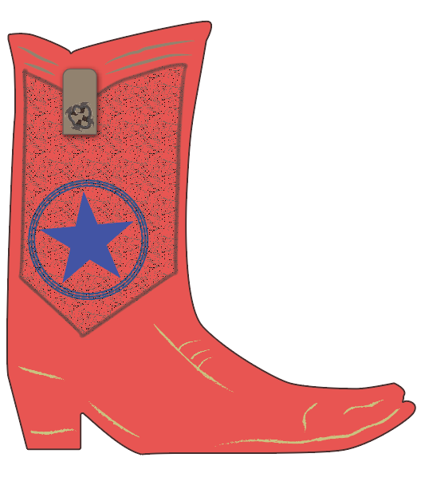
Drawing challenge. Not to submit.
Trace boot and alter the decorative parts as you wish. My version is on the right. The original is on the left.

