Slide 1
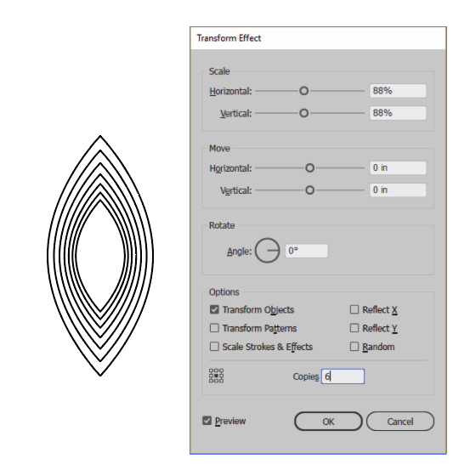
Draw an oval
Use Anchor Point tool to change from smooth point to corner point.
Use EFFECT/Transform and Distort/Transform to do the following.

Slide 2
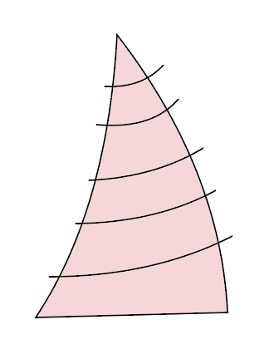
These are cryptic steps. I’ll explain as we go.
Use pen tool to draw a triangle that looks like a right sail. (scalene or obtuse will do.)
Reshape with pen tool: Use Alt-Click to drag …
Deselect
Use Pen tool to make STRAIGHT lines all the way through.
Select all.
Choose Shape Builder
Change colors to “D”
Move cursor over each strip to create separate shape.
Stay with Shape Builder tool and Alt-click on line segment outside to delete each one.

Slide 3
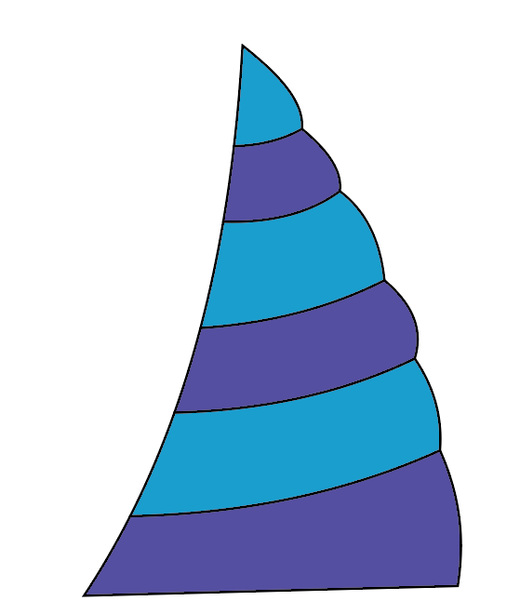
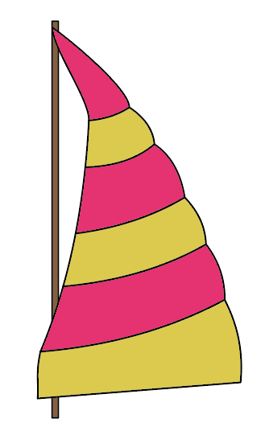
Continue…
Use Direct Select to bulge each strip
Select 3 strips and fill with blue.
Add your blue swatch to your Global colors.
Select your other strips and add a purple Global color
Go to Color Swatches. Double click your blue swatch and change to yellow.
Change your purple color to orange.
Now, turn on the Draw Behind mode and draw a mast behind the sail.

Slide 4
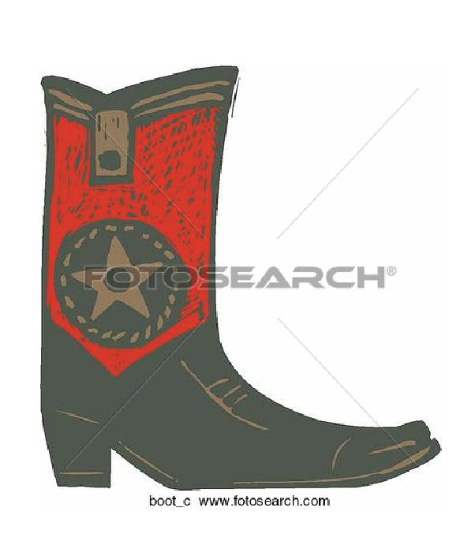
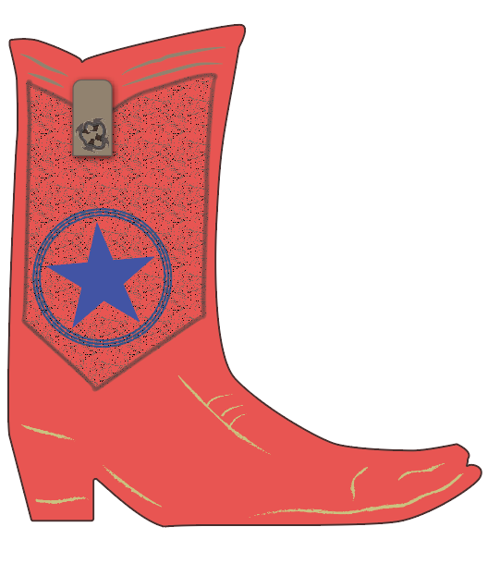
Drawing challenge. Not to submit.
Trace boot and alter the decorative parts as you wish. My version is on the right. The original is on the left.

Slide 5
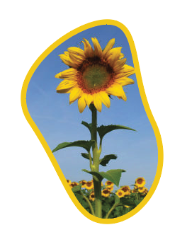
Clipping Mask
A clipping mask is an object whose shape masks other artwork so that only areas that lie within the shape are visible.
Only vector objects can be clipping masks; however, any artwork can be masked.
Regardless of its previous attributes, a clipping mask changes to an object with no fill or stroke.
Steps
Draw object to be used as mask.
In stacking order, the mask/path goes on top of the image to be masked. If you want to get stroke again, target your path in the Layer panel. Then display the stroke panel in order to add a stroke.

Slide 6
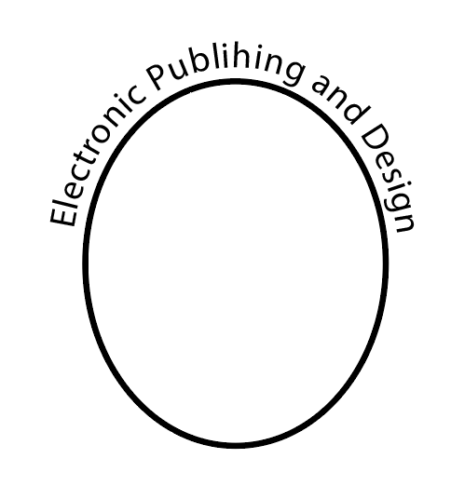
Type on a Path
Use the same method that you did in InDesign and Photoshop. The Difference is that you lose the stroke.
If you need the stroke, copy and paste it.
Then go into the type with the Type tool and delete all text. Then select the (invisible) path with the direct or group selection tools and give the path a stroke.

Slide 7
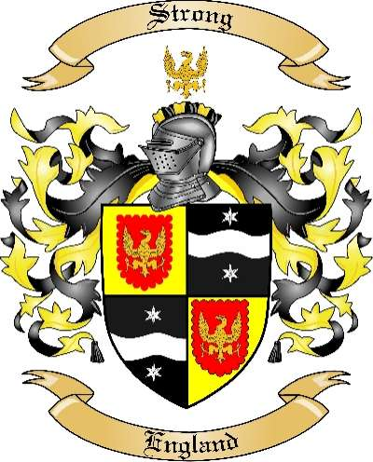
Create a Family Crest. Not to submit.
We will start thinking about creating a family crest on Monday as we explore www.vecteezy.com. Then on Wednesday, you’ll actually design the crest with a little help from vectors at Vecteezy.
Vecteezy is one of several websites providing free (and premium) vector images. As designers, you will probably finding yourself using parts of the images so that you can create custom and unique designs.
As a way of exploring the site in a focused way, you will create a design that would be suitable for a family crest. A family crest usually consist of a shield, crest, family motto, visual representation of family values, and other ornamentation.
Optional. Feel free to take a quick look at a list of family values, associated colors and symbols at: http://www.mytribe101.com/crest

