Slide 1
CSS Photo Gallery or Slideshow
By: Kate Lambert and Abel Sanchez

Slide 2
Slideshows

Slide 3
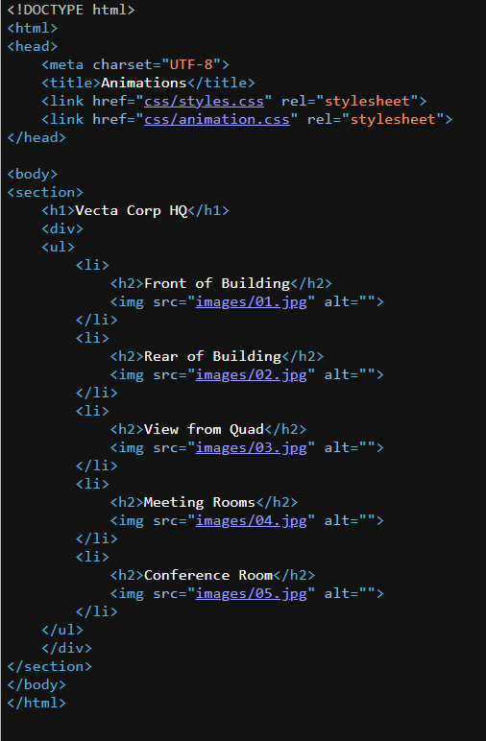
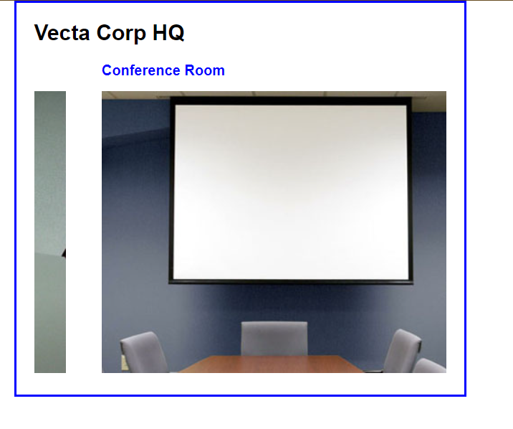

Slide 4
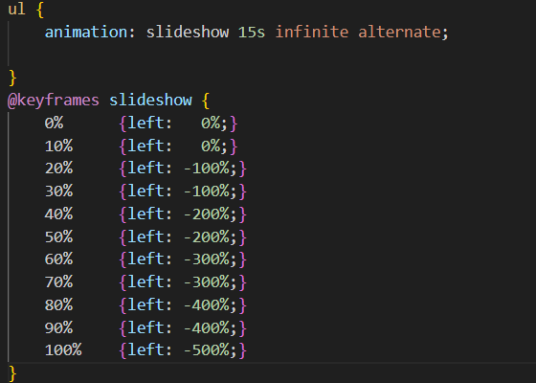

Slide 5
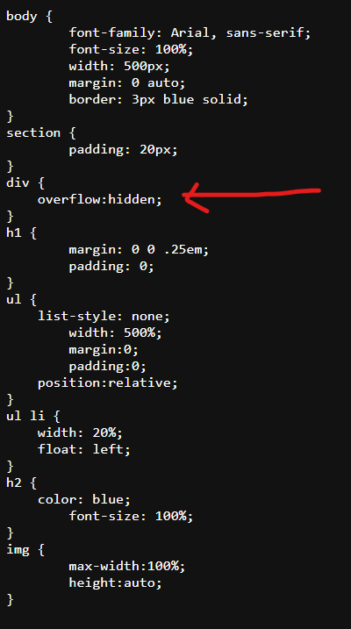

Slide 6
This can be found in pg 486-487 or Book examples chapter 15 06_Animations

Slide 7
Other Ways to make a Slideshow
https://www.w3schools.com/w3css/w3css_slideshow.asp
https://www.w3schools.com/howto/howto_js_slideshow.asp

Slide 8
CSS Photo Gallery

Slide 9
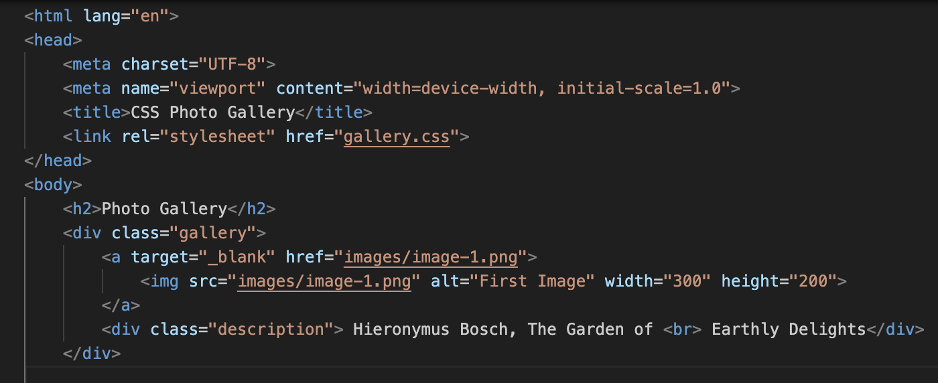
First Part of Code (HTML)

Slide 10
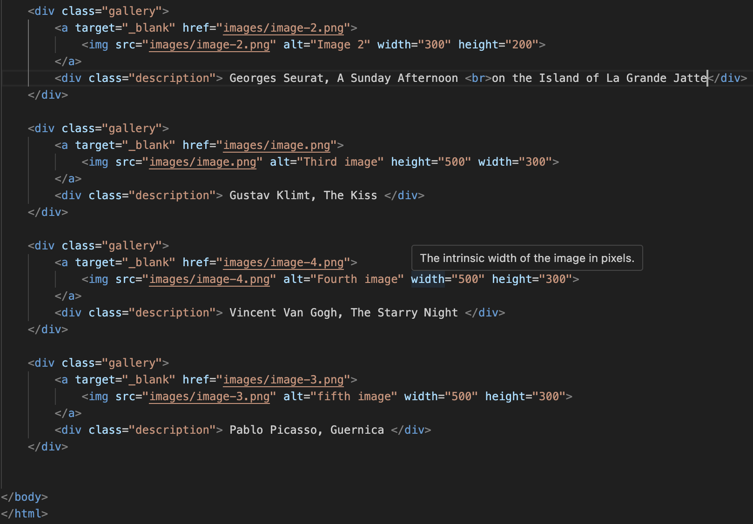
HTML Continued

Slide 11
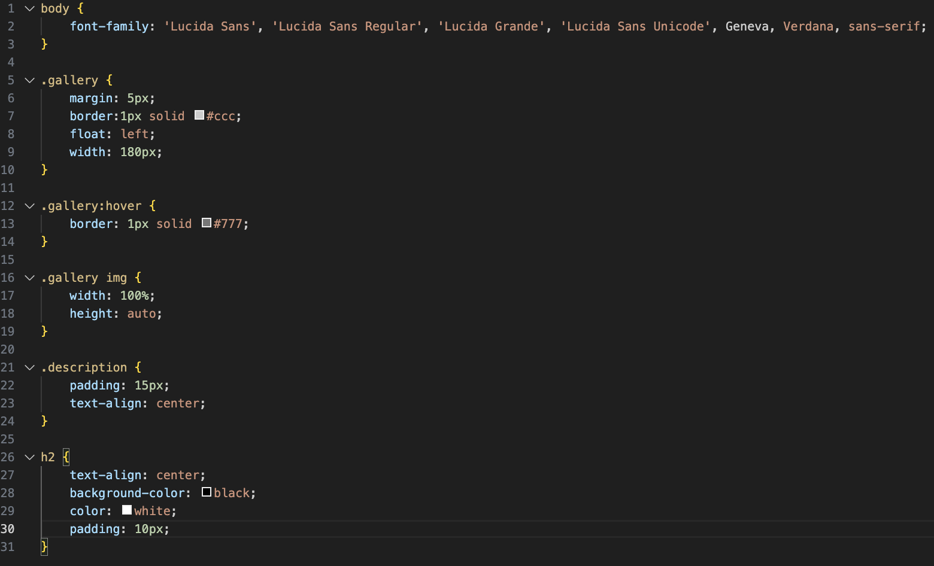
CSS Section

Slide 12
LINK:

