Slide 1
Website Typography

Slide 2
What is Web Typography?
01
02
03
04
Typography refers to how text looks to readers
“Typography plays a critical role on any website by ensuring we can comfortably read and process all its text-based content. If a website’s typography works, we won’t notice. If it fails, chances are we’ll bounce off the page.” - hubspot

Slide 3
Why Typography?
Readability
Accessibility
Responsive Web Design

Slide 4
Readability
01

Slide 5
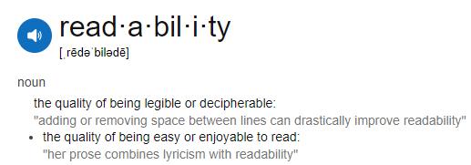

Slide 6
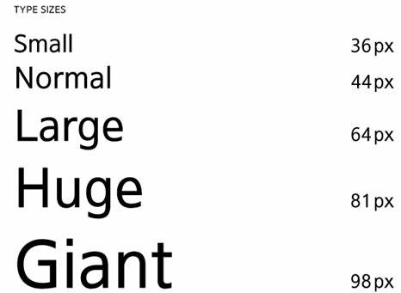
HTML and CSS Tricks & Tips for Readability
Font-weight – Try to reserve bold text for headers or as accents. Fonts that are too light or heavy make body text hard to read. A font weight of 400px is standard.
Font Size - Avoid font sizes that are too small and too large. A good font-size for body text is between 12 and 20px. Headings should be about twice as large as text, so between 24 and 40px.
Lists - Using lists helps to sort information, making it easier to read.

Slide 7
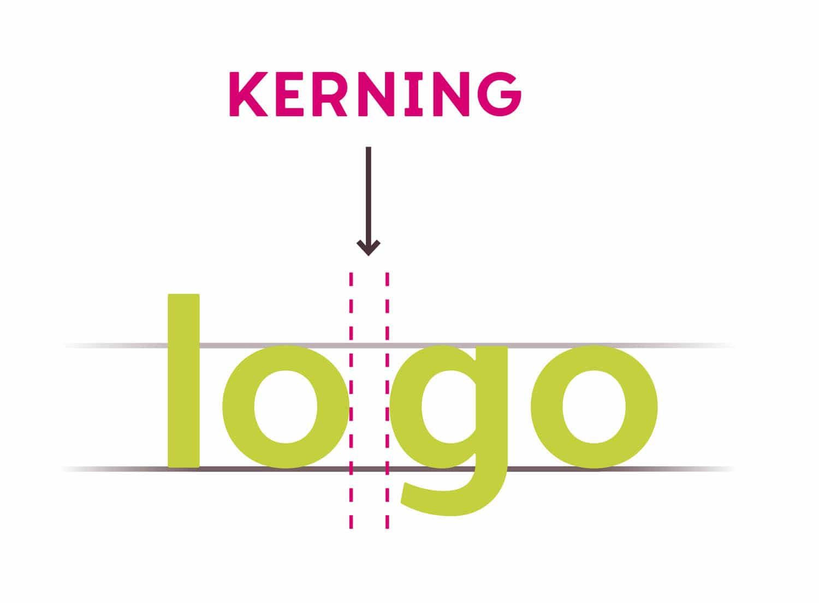
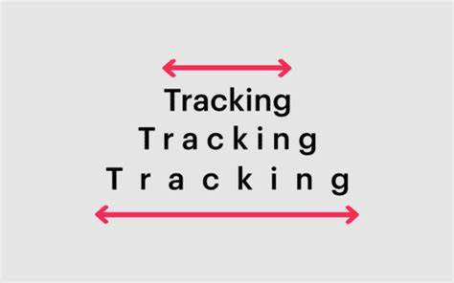
Tricks for CSS readability:
Text-Hierarchy: Allows differentiation between content
Kerning - refers to the spacing between certain letters. Often for design purposes. Property=font-kerning.
Tracking-Refers to equal spacing between letters.
Property=letter-spacing.

Slide 8
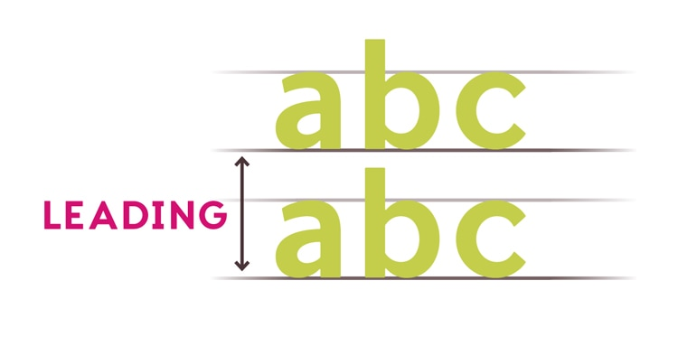
Leading-Spacing between lines (single/double- space).
Property: line-height.

Slide 9
Typeface, Fonts, & Readability
The typeface and font you pick plays a huge role in readability.

Slide 10
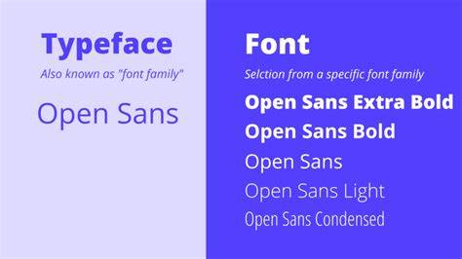
Typeface vs Font
Typeface: Family of characters with the same features.
Font: style, weight, and size of typeface.

Slide 11
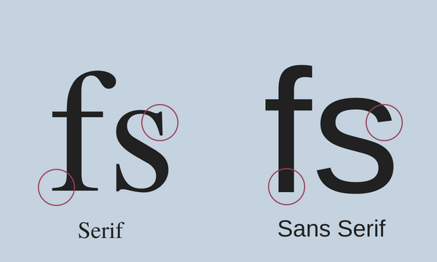
Serif vs Sans-serif
Serif:
*Strokes/feet at the end of characters
*Easier to read on printed material.
Sans-serif:
*Sans=no in French. No feet at the end of characters.
*Easier to read on digital material.

Slide 12
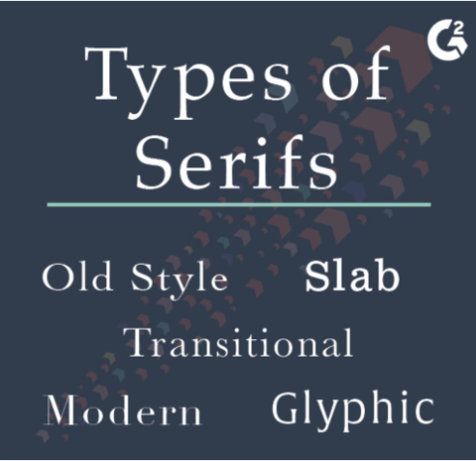
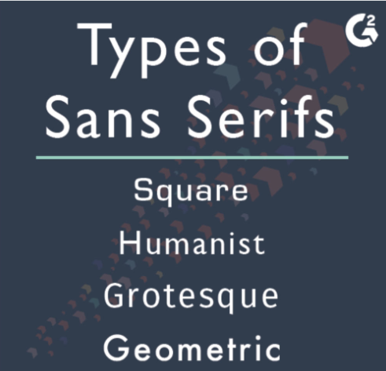
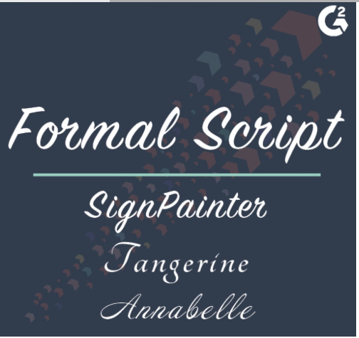
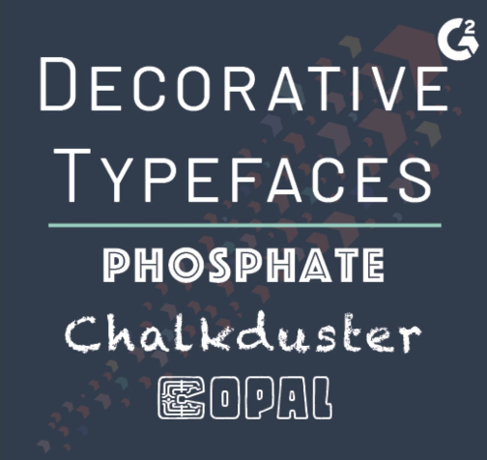
Font Psychology
Adjectives associated
with serif fonts:
* Traditional
* Respectable
* Reliable
* Elegant
* Sophisticated
Adjectives associated
with Sans Serif fonts:
* Clean-looking
* Clarity
* Modern
* Elegant
* Efficient
* Straightforward
Adjectives associated
with Script fonts:
* Elegance
* Creativity
* Uniqueness
* Personal
* Emotional
Adjectives associated
with decorative fonts:
* Casual
* Creative
* Original
* Flexible
Info from designmodo

Slide 13
ACCESSIBILITY
2

Slide 14
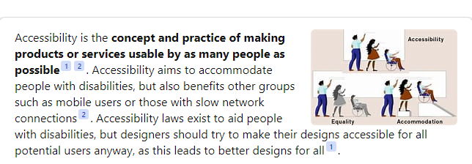
ACCESSIBILITY

Slide 15
ACCESSIBILITY GUIDELINES
Accessibility and Readability
Web Content Accessibility Guidelines
A lot of the things mentioned earlier that are used to increase readability also help to increase accessibility.
*Guidelines made by W3 (Also guidelines made by by ADA).
*Four main principles of WCAG: Perceivable, Operable, Understandable, Robust.
*View distinguishable->text-spacing.

Slide 16
Testing CofC Accessibility
There are many tools to test accessibility of a website online. Here’s one:
Tool: Deque
https://charleston.edu/

Slide 17
Most Accessible Typefaces
*Arial
*Times New Roman
*Helvetica Neue
*Verdana
*Helvetica
*Calibri
*OpenDyslexic

Slide 18
3) Responsive Web Design
It is important that text can still be read easily across devices and browsers.

Slide 19
How to make websites more responsive
https://www.w3schools.com/html/html_responsive.asp

Slide 20
Thanks!
*https://fonts.google.com/knowledge/using_type
*https://blog.hubspot.com/website/website-typography
*https://www.accessibility-designer-guide.com/docs/design-rules/typography/#for-which-users-can-incorrect-typography-be-a-problem
*https://perthdigitaledge.com.au/blog/10-key-web-design-strategies-to-improve-user-readability/#:~:text=Choose%20the%20right%20fonts%20and%20font%20sizes%20for,test%20readability%20with%20tools%20to%20optimise%20website%20performance.
*https://audit.deque.com/summary
*https://www.w3.org/WAI/standards-guidelines/wcag/
*https://opendyslexic.org/
*https://designmodo.com/font-psychology/

