Slide 1
Introduction NOTE: This is a real chapter
Processing Programming

Slide 2
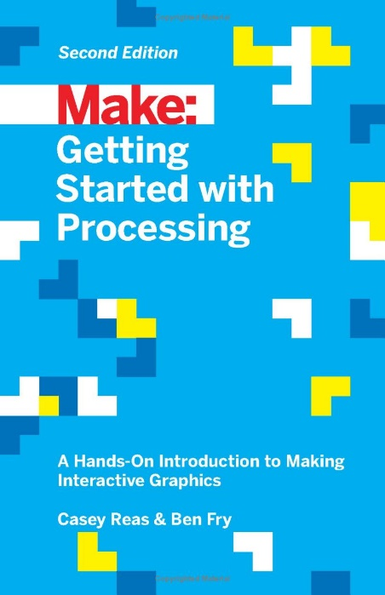
Introduction
MAIN POINTS
Who is book for?
Who is Processing language aimed at?
Open source
Algorithm
Incremental development
Who developed Processing language?
Programming language it’s built on

Slide 3
A Few Definitions
Processing is an opensource programming language for coding within the context of the visual arts and electronic media.
Incremental Development is a method of software development where the product is designed, implemented and tested incrementally (a little more is added each time) until the product is finished. It also involves modularity. E.g., space invaders
Algorithm: Sequence of instructions that tell the computer what to do to solve a problem (works like a recipe)

Slide 4
Chapter 1 PIXELS

Slide 5
X & Y Coordinates
X axis +
(0,0)
NOTE: 100 pixels equals approx. 1"
+ Y axis

Slide 6
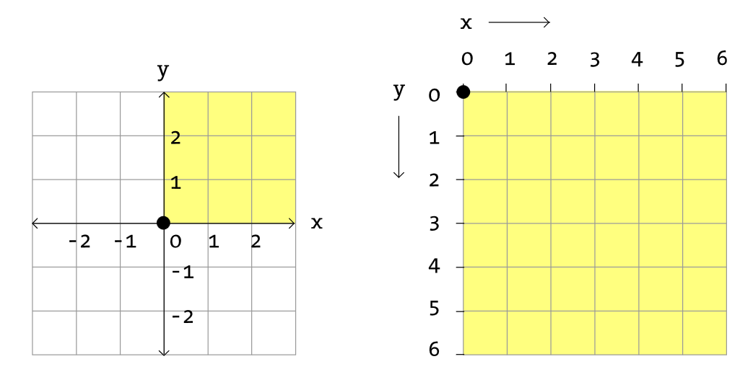
Coordinate Systems
Cartesian
Processing

Slide 7
Simple shapes
Examples: point, line, ellipse, rectangle, quad
In order to “give a command” to tell it to draw a shape, we use built-in functions.
functionname(arguments);
Example of rectangle function showing parameters, then values.
rect(x, y, width, height);
rect(30, 40, 20, 50);

Slide 8
More definitions
Don’t write down definitions. Maybe just words.
Functions: modules of code that accomplish a specific task. Functions usually "take in" data, process it, and "return" a result.
Variable: a placeholder value that can change, depending on conditions or information passed into the program.
Parameter: a special kind of variable that is passed into a function. It specifies the type of data…
Argument: the actual value that is passed into the function.

Slide 9
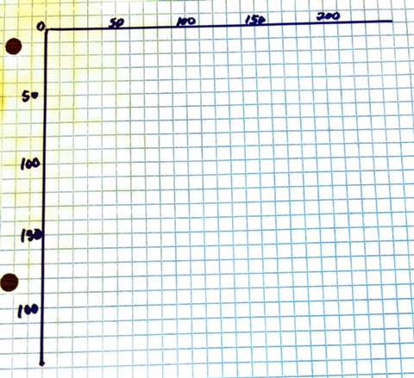
Do exercise on graph paper
Oops, the last number
should be 200
See specifics on next slide

Slide 10
Line(x, y, x, y); line(20, 20, 180, 20);
Point(x, y)
stokeWeight(5);
point(50, 50);
point(0, 80);
rect(x, y, width, height);
rect(100, 100, 100, 100);
Same as rectangle but from the center
ellipse(30, 90, 50, 50);

Slide 11
TRY IT: Let's input your shapes from the graph paper!

Slide 12
Color
Using grayscale colors:
Color is defined with numbers ranging from 0-255.
Based on binary numbers of only 0 & 1; 8 bits in each byte.
Thus 2^8 is 256, meaning there are 256 combinations of 0’s and 1’s to represent black to white.
0 50 87 162 209 255
In Processing, you can apply color as:
fill()
stroke()
background()

Slide 13
TRY IT: Create these rectangles in grayscale colors
Set screen size to 300. Then try to guess what the instructions would be for the following screenshot.
Textbook Exercise 1-4

Slide 14
COLOR (continued):
Using full RGB colors:
Primary colors for screen devices are include green rather than yellow.
When combined, there is a possibility of 16,777,216 colors or 2^24.
Example of a function is
Get to know popular color combinations.
background(0, 255,255);
QUESTION FOR YOU:
What is used to control transparency of colors?

Slide 15
COLOR (continued):
Another color system is hexadecimal
Based on 16 number system: 0-9 and A-F
Examples:
background(#00FFFF);
fill(#FF0000);
stroke(#C80096);
See TOOLS>Color Selector menu.
Video on dec to hex

Slide 16
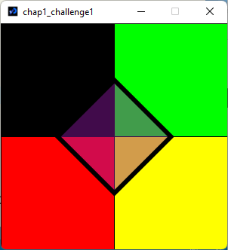
Challenge: Extension of Exercise 1-4
Change your grayscale colors to primary.
At end of sketch, change the stroke weight to be thicker. …Next…
Go to HELP> Reference and look up quad().
Place a diamond shape on top your squares.
Fill diamond with a semi-transparent color.
Run
If time, go back and remove stroke from diamond

Slide 17
Quick Answer:
size(300, 300);
fill(0);
rect(0, 0, 150, 150);
fill(0,255,0);
rect(150, 0, 150, 150);
fill(255,0,0);
rect(0, 150, 150, 150);
fill(255,255,0);
rect(150, 150, 150, 150);
strokeWeight(6);
fill(150, 25, 175, 110);
quad(150, 75, 225, 150, 150, 225, 75,150);

Slide 18
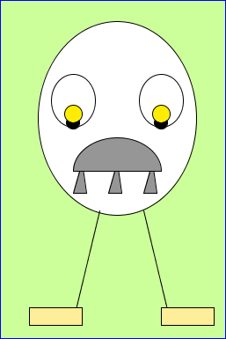
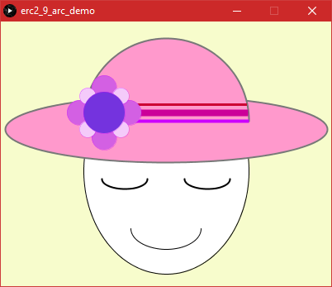
Exercise 1-7 … a reminder
Try to do all examples and exercises…
Feel free to ask about them in class…

Slide 19
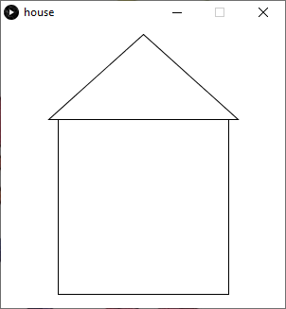
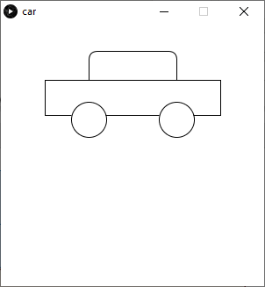
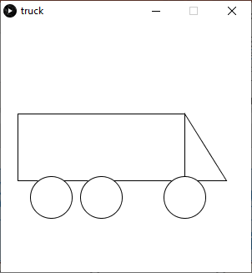
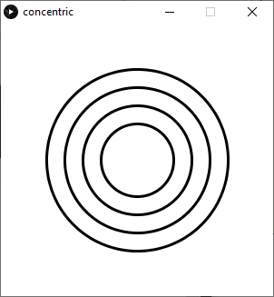
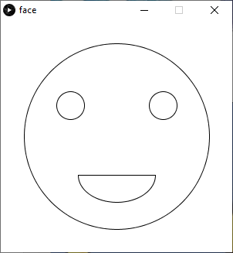
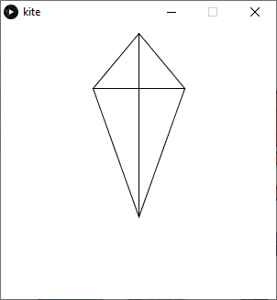
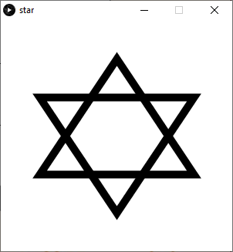
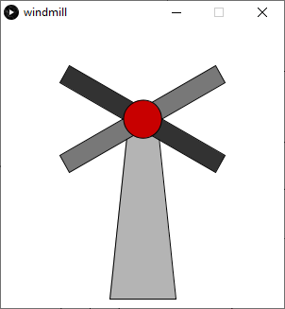
Other ideas for Chapters 1 & 2
I kept these simplistic, but you can go further if desired. The idea is just to get your bearings right regarding shapes and coordinates.

Slide 20
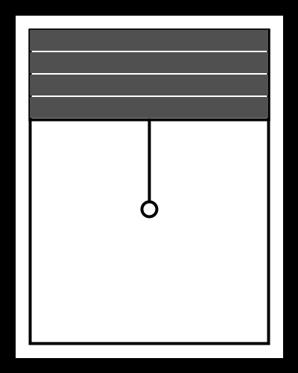
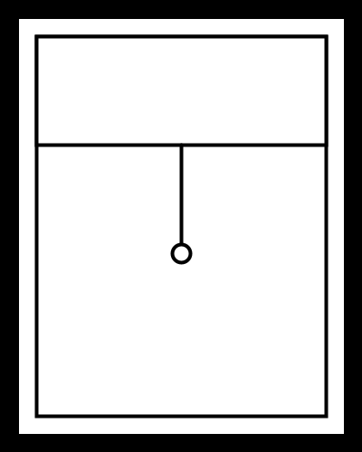
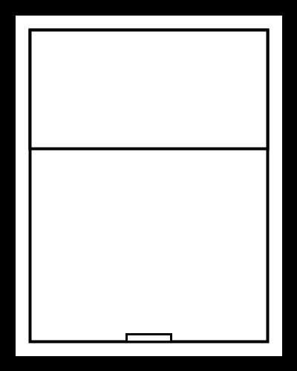
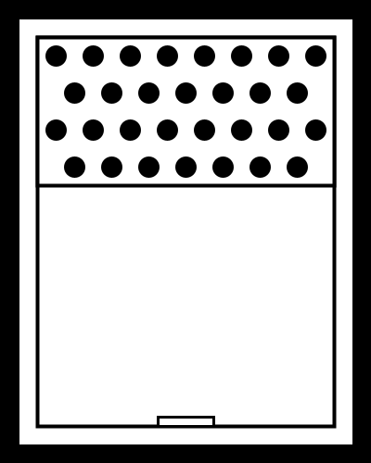
Even more ideas. These are windows.
I saw this collection of windows on a vector drawing site. I re-created them in Processing. Try one! It helps to get you acquainted with coordinates and sizing for sure.

Slide 21
Chapter 2 (Preview)
We’ve already touched on some of Chapter 2
Official intro to the software.
Downloading (You did already)
Saving files; Location
Saved in folder with same name; reason
HELP/Reference
Use comments generously
Println() and Error in console help with debugging
Textbook website

