Slide 1
Chapter 4, Variables:
What to expect:
Continue to program more efficiently by using variables. Allowing information to change creates more dynamic programs.

Slide 2
Definition
Variable:
A value that can change, depending on conditions or on information passed into the program.
What are other synonyms or ways to describe variable?

Slide 3
Types of Variables
These are the common types
int: Whole numbers – positive and negative; i.e., a large number -2,147,483,648 to + 2,147,483,647)
float: A number with decimal places, such as 3.14159
char: A character such as “a” or “b”
boolean: True or False
See page 52 for others

Slide 4
Rules for naming variables
Best Practices/Tips
One word, no spaces
Cannot start with number
No punctuation or special character except “_”
Must be unique
Names should be meaningful.
Avoid words that appear elsewhere in Processing, such as width, height, key, mouseX, etc.
camelCase is a good idea

Slide 5
Declare and initialize variables
You can declare a variable by stating the type and the name: int starter;
Or you can declare and initialize at the same time: int starter = 1;
Variables can be initialized by another variable or by a mathematical expression. float counter = x+10;

Slide 6
Using Variables
Example of built-in/system variables: rect(mouseX, mouseY, 18,18);
Example of variable you create: int sizeWidth = 10;
… ellipse(50, 50, sizeWidth, 20);

Slide 7
Making them “vary”
Examples of assigning new value
sizeWidth = sizeWidth +1;
posY = PosY * 2;
x = x - 1
Note assignment operator =
Note arithmetic operators
+ - / *

Slide 8
Example 4-3

Slide 9
Follow the sequence of steps to create a rect that uses variables.
Type these two lines to create the variables. int rectX = 0; int rectY = 270;
Set a 300 by 300 size window.
Set a background color (you decide where)
Set a fill color.
Type this line, using variables to set the rectangle’s location. rect(rectX, rectY, 30, 15);
Run sketch to make sure that the shape appears.

Slide 10
Continued…
Add this line so that x position increases by one. rectX = rectX + 1;
Run the sketch
______________________________
Try this: Instead of horizontal movement, make the rectangle move upward. ????????
If time permits: Fill the rectangle with any kind of random colors.
????????

Slide 11
Think of the flow Example 4-3:

Slide 12
System Variables
Some of the commonly used built-in variables:
width, height
frameCount, frameRate
displayWidth, displayHeight
Key, keyCode
keyPressed, mousePressed
An Example:
ellipse(width/2, height/2, 50,50);

Slide 13
Plain English example | Syntax of if statement | Real example
if(it rains tomorrow){ leave early for class wear rainboots take the shuttle bring an umbrella } otherwise { wear sandals walk to class } | if (condition test) { //code to run } else { //code to run } | if (keycode == UP { y = y -1; }else { y = y +1; } Full program: Press Ctrl-A. Then Copy
//User move stick up and down
int x = 150;
int y = 200;
void setup() {
size(300,500);
rectMode(CENTER);
}
void draw() {
background(0);
rect(x, y, 16, 150);
ellipse(x, y-60, 40,40);
}
void keyPressed() {
if(keyCode==UP) {
y=y-3;
}else {
y=y+3; //any key will move it down
}
}//end keypress

Slide 14
Random
Random is a math function that returns an unexpected value within a specified range.
Syntax: random(high) random(low, high)
Random returns floating point numbers. To convert to an integer, enclose it in the int() function: int w = int(random(low, high));
funprogramming.org– mix Exam 4-3 with #9

Slide 15
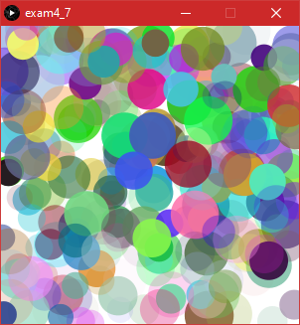
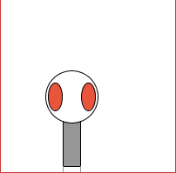
More Play with Random
Jiggling
Example 4-7:
Why are the variables initialized in draw()?
Try initializing at top of program.
Exercise 4-6:
How did you make Zoog jiggle?
Friday 9/24
Need one Volunteer to show Exercise 4-6 Plus show same technique in a design of your own.

Slide 16
Very small dip into Chapter 17
First, let’s revisit page 24.
println()
Prints information to the console. Often good for debutting
Text function
Syntax: Text( text or variables, x position, y position);
Example1: text ("Know Thyself", 15, 70);
Example 2: text(“The width is: " + displayWidth, 10, 40);
Related: fill()
textSize()

Slide 17
Translate
The translate() function specifies a horizontal and vertical offset for shapes. However, we will cover it in Chapter 14 where more meaningful examples can be applied.

