Slide 1
Chapter 1
Introduction to web development

Slide 2
Basic Definitions
Network – Two or more computers connected that can exchange data and share resources with each other.
Internet – The interconnected network of computer networks that spans the globe and is used for providing a variety of information and communication tools.
Networks use a system of rules, called Communications Protocols to transmit information over physical or wireless technologies.

Slide 3
The components of a web application
Server:
A computer or computer program which manages access to a centralized resource or service in a network.
Client:
Device that accesses services provided by a network. Examples include PCs, tablets, and mobile devices that access webpages through browsers.

Slide 4
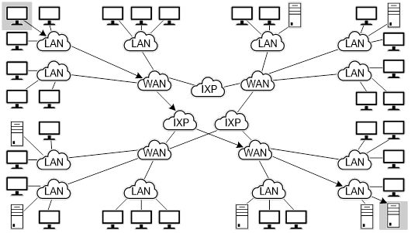
The architecture of the Internet
Deep understanding of networks not needed for the course.
Conceptual knowledge and exposure to some key terms suffice.

Slide 5
Let’s Talk
What can you tell us about?
LAN
WAN
ISP
Router

Slide 6
Static vs Dynamic websites
Static websites appear the same for every user that accesses them and only change when a developer modifies the source files.
Dynamic websites can present different information to different visitors. Sometimes called interactive.
Dynamic websites employ languages in addition to HTML/CSS.
e.g., JavaScript, PHP, ASP.net, Python, etc.
More information (optional)

Slide 7
Processing of webpages
How a web server processes a static webpage vs. dynamic webpage.

Slide 8
How JavaScript fits into this architecture
Some common uses of JavaScript
Data validation on forms
Carousels, image swaps & rollovers
Remembering user information
Slide shows
Mobile navigation menus
Web application and games
Popup windows

Slide 9
…Skipping thru the technical pages of writing HTML, tools, and viewing a webpage. because…

Slide 10
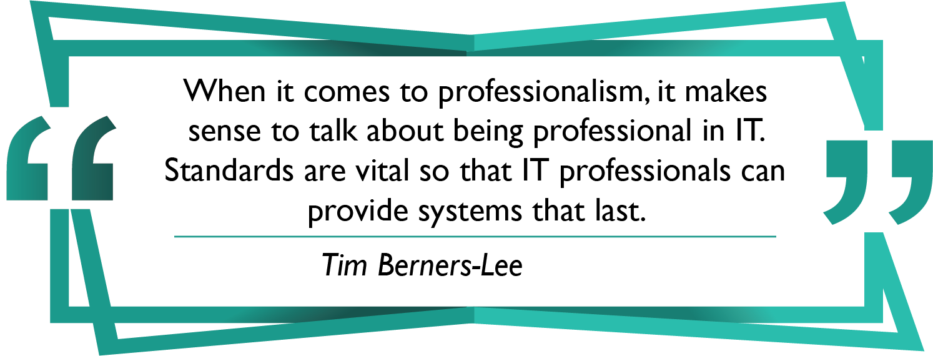
Setting the Standards
World Wide Web Consortium (W3C) https://www.w3.org
Web Hypertext Application Technology Working Group (WHATWG) https://whatwg.org

Slide 11
Tools for web development
Four free text editors
VS Code
Notepad++; TextMate
Brackets
Codepen
Two of the IDEs* for web development
*IDE is Integrated Development Environment
Adobe Dreamweaver
AWS Cloud9
Some free FTP clients
FileZilla
FireFTP
Classic FTP

Slide 12
Approaches to Website Creation
Text editors – Visual Studio, Brackets, Notepad, Sublime…
Web editors – Dreamweaver, Google Web Designer, AWS Cloud
Website builders – Wix, Squarespace, Weebly …
Web framework - AngularJS, Bootstrap, ReactJS, Django… (Want to know more? What is a framework?)
Content Management – WordPress, Cascade…
We will take the hard road

Slide 13
Why do it the hard way?
Web site development is much more sophisticated than HTML & CSS.
It’s changing, but always the standard.
Need to be able to tweak codes from web editors.

Slide 14
What is HTML?
HTML (Hypertext Markup Language) is a special language which tells the browser how to format text in a WWW document.
HTML provides structure and semantic information
CSS (Cascading Style Sheets) sets appearance and page layout

Slide 15
HTML Syntax
Contains tags that dictate how the content will appear, i.e. formatting.
Examples:
<b>Happy</b> Applies bold to the word
<br> Breaks the line
Most tags are paired, <p> </p>
Some are stand-alone, <img>
Some tags include attributes that alter the basic command, for example:
<h1 class="feature">Welcome</h1>

Slide 16
Other Characteristics
The format is text files, with .htm or .html extension.
Hard returns, tabs, and extra spaces are ignored.
DO NOT use spaces in file names.
File names ARE CASE SENSITIVE.
Tags are not case sensitive, but the standard is lowercase.

Slide 17
Let's Talk
From reading or general knowledge, what do you know about:
URL meaning
URL parts
Case sensitivity of URLs
Versions of HTML
Versions of CSS
File name of first page of website

Slide 18
Homepage Name
The first page in a website should be named index.html Because it is the default filename, it nicely shortens your URL
example: www.cofc.edu instead of:
www.cofc.edu/homepage.html

Slide 19
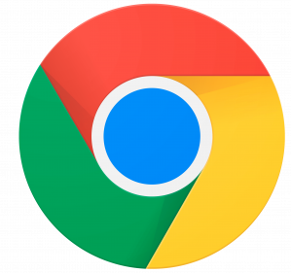
Displaying an HTML File
Use any browser software – such as Chrome, Firefox, Internet Explorer, Safari, etc.
Also, use any OS —such as Windows, IOS, Linux, Android, etc.

Slide 20
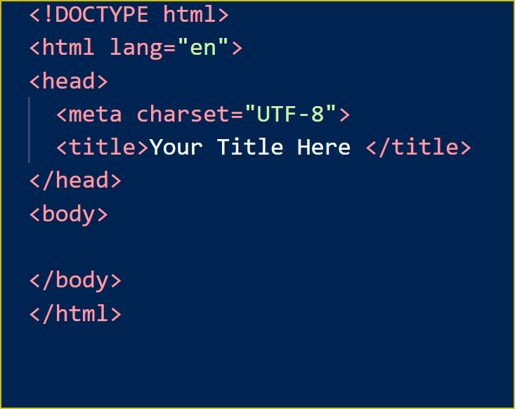
If time permits, I will explain
Parts of an HTML page
…from page 13

Slide 21
Another jump start with HTML
Go to www.Codepen.io
As time permits, we will practice these elements
Heading
Paragraph
Line break
Italic and bold
Bulleted list

Slide 22
Four issues for web developers
This is good stuff! I’ll assign the topics so you can the voices of your peers. Will be due next week.
Responsive web design
Cross-browser compatibility
Web accessibility
Search engine optimization (SEO)

